Slide 1
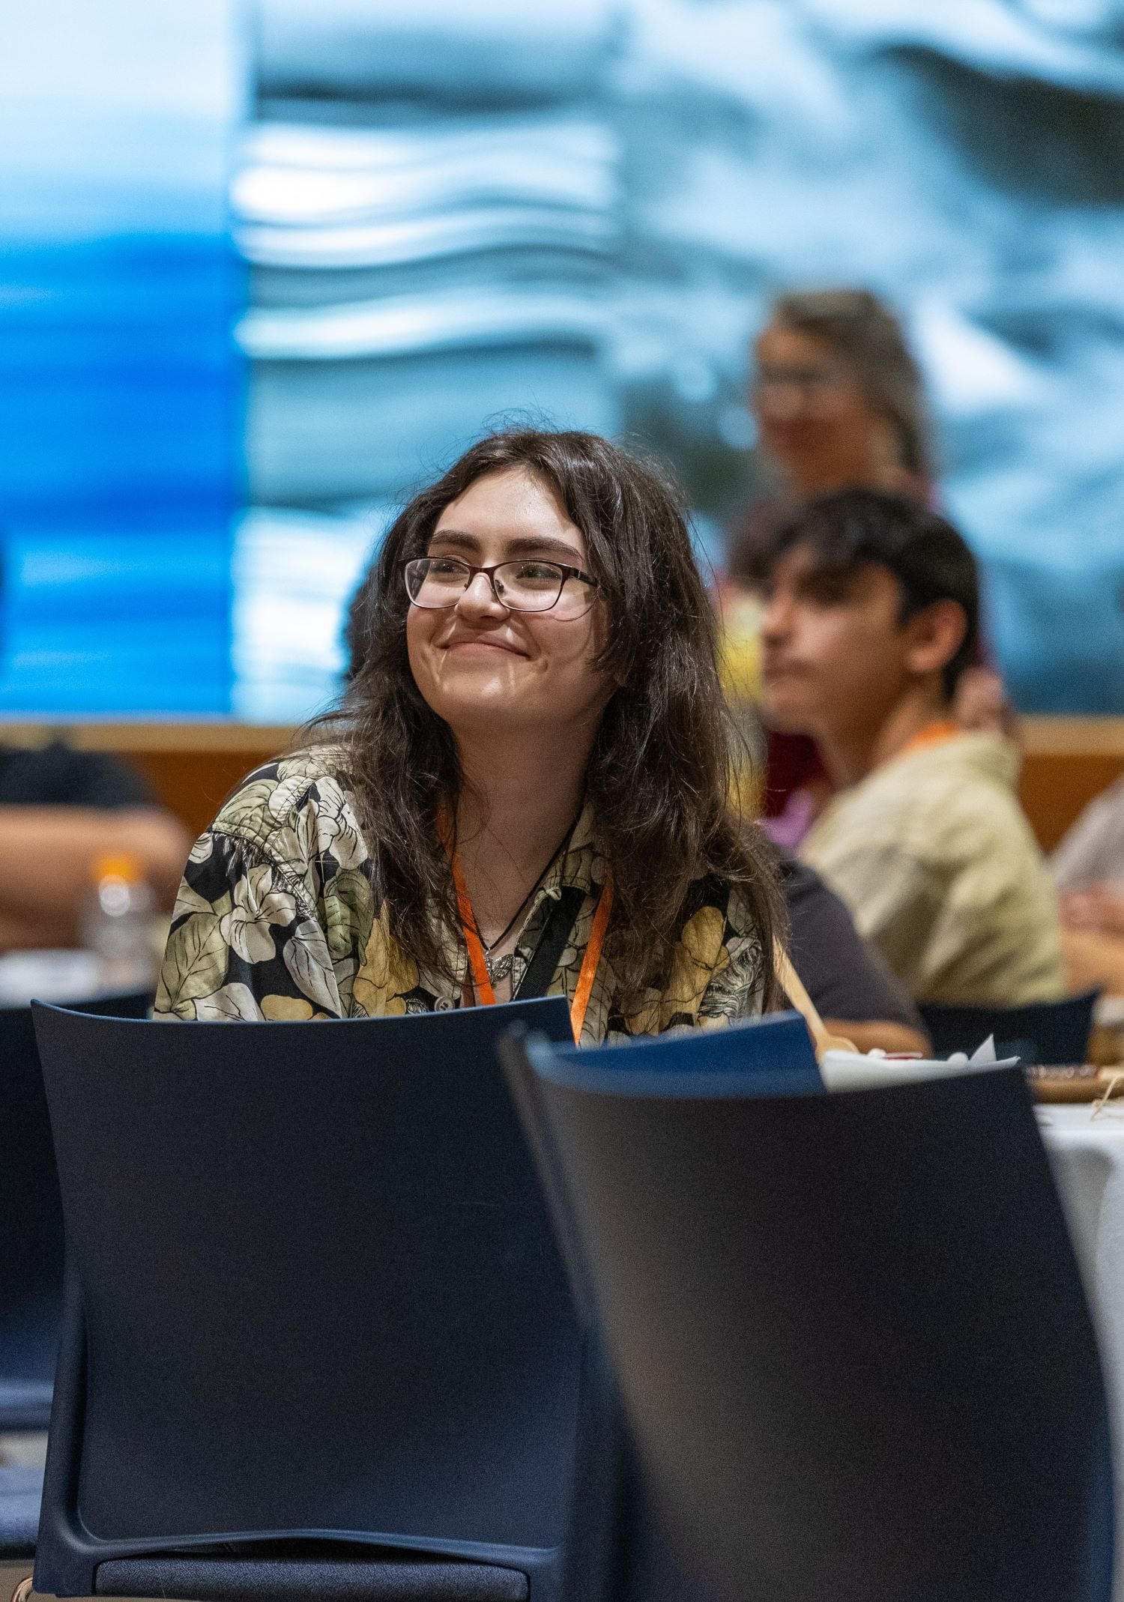




OREGON STATE UNIVERSITY
SUPPORTING STUDENTS THROUGH THEIR ONBOARDING EXPERIENCE
Clare Creighton, Office of Academic Support
Carla Harcleroad, University Advising
Notes:
Welcome!
Introductions

Slide 2

Agenda
OSU onboarding goals
Common strengths & challenges
Onboarding overview
Techniques for scaffolded support
Discussion/Practice
3

Slide 3

Our Goals for Students
Connect: Build relationships and find inclusive community at OSU.
Navigate: Learn to confidently navigate and utilize OSU support systems and resources.
Prepare: Develop the skills necessary to succeed academically.
Engage: Engage new experiences that facilitate growth and learning.
Balance: Establish and engage in learning strategies for personal and community health and wellbeing.
Notes:
Our new student onboarding experience is designed based on feedback from students and family members over the last several years as well as a deep body of knowledge and research on how to support students in transition to a new academic environment.
We think of on boarding as beginning when students make their commitment to come to OSU and lasting throughout their entire first year at OSU the reason we have onboarding framed over such a long term is that we are eager to help students truly build skills and create support networks that support them when we frame orientation as a single day in the summer and try to put all of our emphasis on that day we are able to accomplish as much collectively in providing support to students so part of what you'll hear me talk about today is this long journey that we have students on but we're helping them build the skills the need and the support systems to help them be successful.
When we talk about our what you'll see on the scale on the slide what you'll see on this slide are our five goals for students during their onboarding experience short hands they are connect navigate prepare engage and balance. These goals are ones that we consider to be a shared effort and responsibility that we frame as a component of this is the university commitment and part of this is an expectation for students as well. We are sharing this with you as a supporter of students and as someone who can be part of the partnership that helps students accomplish these goals.
Let’s look at connect we want them to build relationships and find community at OHSU we can design and deliver opportunities for students to make connections support them how to in learning how to build community and participate in communities and engage and model shared responsibility for inclusive community. For students their part of that effort that helps accomplish this goal . . . to participate in those activities they need to use the opportunities we provide to create to build relationships form connections and contribute positively to this inclusive community we're trying to build so that's a piece of where we're talking about that shared responsibility there.
If you look at prepare that's an area that I'm deeply passionate about the university always do faculty and staff provides support for students in adapting and developing their learning strategies and study habits from the environment that they were in previously to today's environment and to build their skill set up to be able to succeed academically at OSU and for students that's going to take some internal work as well assessing their own academic skills reflecting on what's working for them developing learning strategies and habits that are necessary for this academic environment so again it's that shared connection point.
The other three that I haven't touched on we want students to learn to navigate and use OSU support systems we want them to engage in new experiences there's a lot of opportunities on this campus so we want them to seek out opportunities that will help promote growth and learning for them as students and establish strategies for personal and community health and well-being so we want them to be balanced in their experience as students. So those are our new student onboarding goals for students.
It’s a shared effort and responsibility, invite you into this partnership as well in helping students accomplish these goals.
Connect: Build relationships and find inclusive community at OSU.
University Commitment: Design and deliver opportunities for students to make connections. Support students in learning how to build and participate in inclusive communities. Engage with and model shared responsibility for our inclusive community.
Student Action/Tactics: Students will participate in activities and experiences to build relationships, form connections, and positively contribute to the OSU community.
Navigate: Learn to confidently navigate and utilize OSU support systems and resources.
University Commitment: Teach students about the resources available at OSU and help them build agency in navigating resources and systems.
Student Action/Tactics: Students will identify their needs, learn how to access, and utilize resources to achieve their goals.
Prepare: Develop the skills necessary to succeed academically.
University Commitment: OSU faculty and staff will support students in adapting and developing their learning strategies and study habits to this environment.
Student Action/Tactics: Students will assess their academic skills and develop learning strategies and study habits necessary for the university learning environment.
Engage: Engage new experiences that facilitate growth and learning.
University Commitment: OSU will help students understand the importance of experiential learning, make a variety of opportunities available, and facilitate engagement with those opportunities.
Student Action/Tactics: Students will participate in experiences outside of the classroom that connect to their interests and goals.
Balance: Establish and engage in learning strategies for personal and community health and wellbeing.
University Commitment: OSU will support students’ engagement with strategies and resources to advance personal and community health and well-being.
Student Action/Tactics: Engage with strategies and resources that support personal and community growth, health, and well-being.

Slide 4
Q1
What strengths and skills do students bring with them to OSU that will support their success during the transition?
Discussion
Q2
What challenges might students face during the transition to OSU?
5
Notes:
Part of our session will dig further into how as a university we support those goals happening. But I want to pause.
You have been listening a lot today and I want to pause and take advantage of the expertise in the room. Take a moment and turn to the folks around you ideally someone that you didn't come to Launch with or don't previously know.
Let’s talk about the strengths and skills that students bring with them that will support their success during this transition time. You can think about your own student or students in general.
Also think through a few of the challenges they might face during this transition as well. I'm going to ask for their folks to talk for a few minutes and then we'll gather some examples as a large group.
Gather a few examples of strengths (validate).
Gather a few examples of challenges – add to the charting paper.

Slide 5
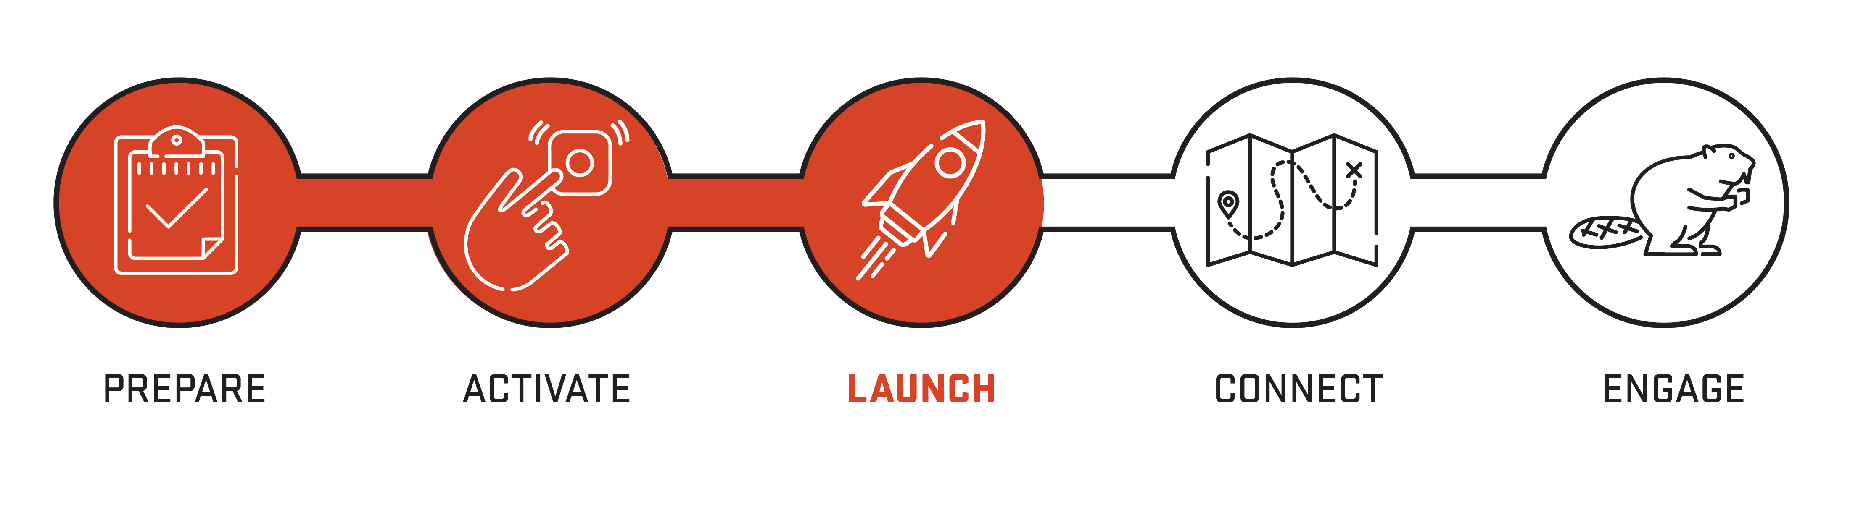
Student Onboarding at OSU
Notes:
This graphic represents our onboarding experience:
The first stage of our onboarding is prepare which is a cluster of online modules 6 of them that take place in our learning management system these modules are designed to prepare students for advising and registration most importantly they contain core knowledge that students need about how our curriculum works now advising will work and the tools that they'll use to go through advising and registration and they also have important information about financial resources that can have intersection points with advising and registration as well so students complete those online modules before they do anything but as their first step.
Second step in our process is activate which is our virtual advising and registration many of the students who are here today have already completed this there may be a few who still have their advising left to do but we would encourage students to do that soon to tomorrow with within the next week or so they'll have steps to complete within Beaver hub and then we'll be able to set up an appointment with an advisor but this chance to connect with an academic advisor gives them guidance on the academic requirements in front of them and the courses to select for their first term at OHSU this is a bit different than our advising approach for most of the rest of their experience there are two what we want to walk students through this first round of course selection.
Next students come to Launch. As Marcella shared this morning our goals here are around meeting other students forming connections becoming familiar with the OU layout and learning to navigate campus and starting to figure out their plans for fall. We focus their schedule on key information, opportunities to answer questions, and time to figure out how to pursue some of their interests. This morning they had parallel sessions to what you all were in, and this afternoon they’ll be in interest rotations – how to pursue their interests, and drop-in questions with partners.
Connect is our pre fall program and I'll speak a little bit about that in a moment and then engage refers to the year long support that students have available to them as they are continuing their onboarding experience and getting settled here at OSU and that's what I want to talk a little bit more about as well.

Slide 6
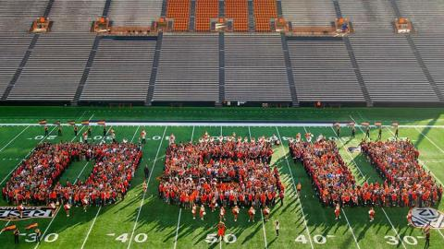
Connect: Moments & Memories
Ongoing communication (email)
Move-In
Connect
First Day of School Photos
Notes:
Five weeks before the start of the term students will start receiving an e-mail campaign from us with timely information on what to be working on and doing to stay on track with OSU. Those communications will go to students OSU e-mail and I mentioned that here so that you can help reinforce the habit and pattern of starting to check emails and staying up to date on the communications that come from OSU.
For students moving to Corvallis, that will begin in mid to late September. With residence hall move in based on a schedule by residence hall. You'll hear more about that in our closing session.
The connect experience is a range of activities planned for students to continue their orientation. Opportunities for applied learning experiences and learning more about how to be successful at OSU.
My office runs Forte which is an academic onboarding experience with a panel of current students talking about how to start off your academic experience on a strong note. We also have fun traditions like our new student walk and convocation.
You're looking at a class photo that is taken every year at the orange and black rally. We also have fun traditions like our first day of school photo booths, the Beaver Community Fair and other fun programs.
So there's a lot of exciting things still to come - today isn't the only day that students are experiencing some of these orientation components. I share that because if we think back to that arc of onboarding and the goals we have – those happen over time.

Slide 7
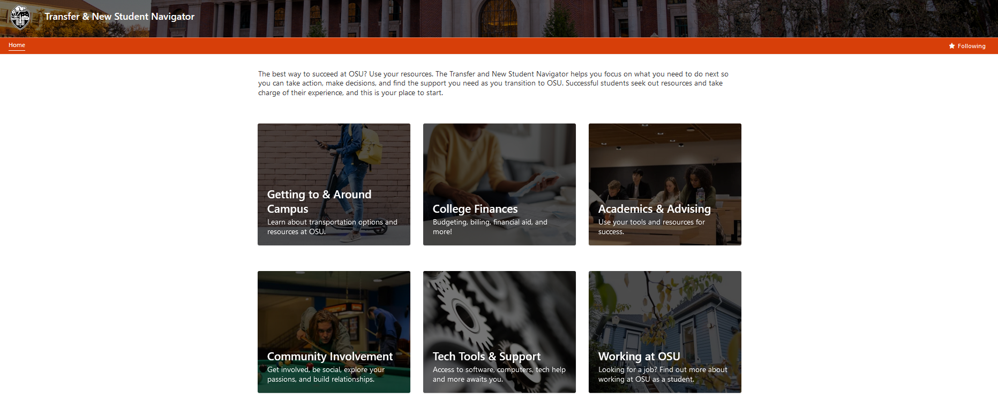
Transfer & New Student Navigator
Notes:
Between now and Connect there are still a lot of great ways to engage with OSU as you and your students prepare to arrive in fall we'll be sending regular emails there's a lot of information on the website and students can think ahead about their journey and what they need to feel ready to start and fall one of the tools they have available to them is the navigator site this is a screenshot of that resource website.
The Transfer and New student Navigator site is a website designed specifically with the first year and transfer student in mind. It is built around key topic areas like transportation, finances, academics, getting involved on campus, working on campus and more. Each area leads to another page with different types of tasks that students might be trying to accomplish. For instance, working at OSU has things from how to search for a job to what paperwork you need to bring with you to make sure that you're able to fill out your employment paperwork when you have a job. There's lots of great information on this page. Since you need an ONID ID to log in, your student is the only one who can access it, it's a useful resource for you to know to be able to prompt students to take a look at: “hey have you checked out any information available on the navigator site yet?” It’s got information about key tasks students are trying to accomplish as well as FAQs they may want to answer.

Slide 8
Important Content
Transitions Course
Academic Success • Healthy Behaviors • Thriving in College • Building Inclusive Communities • Financial Literacy • Career Exploration
Opportunity to Individualize
Personal reflections, class discussions, weekly work on timely topics, and a final tool kit assignment.
5
Notes:
The transitions course is a required course for all new to OSU students.
This course is designed specifically to help students learn some of the key skills and practice some of the important components of a successful transition to OSU .
The content in the course varies whether you're taking a first year transitions course or a transfer student transitions course but includes topics like academic success, healthy behaviors, thriving in college, building inclusive communities, financial literacy and more.
The course is specifically designed to support students and individualizing their own transition so while these content areas are broached broadly the course itself includes personal reflections class discussions frankly work on timely topics and a final assignment that is a toolkit for success in the university. This course is a required part of the overall curriculum as we believe deeply in the importance supporting students in being successful and summer orientation sessions are short. The transfer course provides an opportunity to engage in these topics just in time during the students’ first term.
I share this with you all to emphasize that today isn’t the only time students will hear the information. They started this journey with the online modules and they’ll continue to get information through the year as well. Both in this class and in emails that come from OSU with timely information and tips. In fact this afternoon at our closing session, we’ll go through what to expect in the next 90 days with the whole group together so you’re on the same page about what is coming up next.
With that, I want to turn things over to Carla.

Slide 9
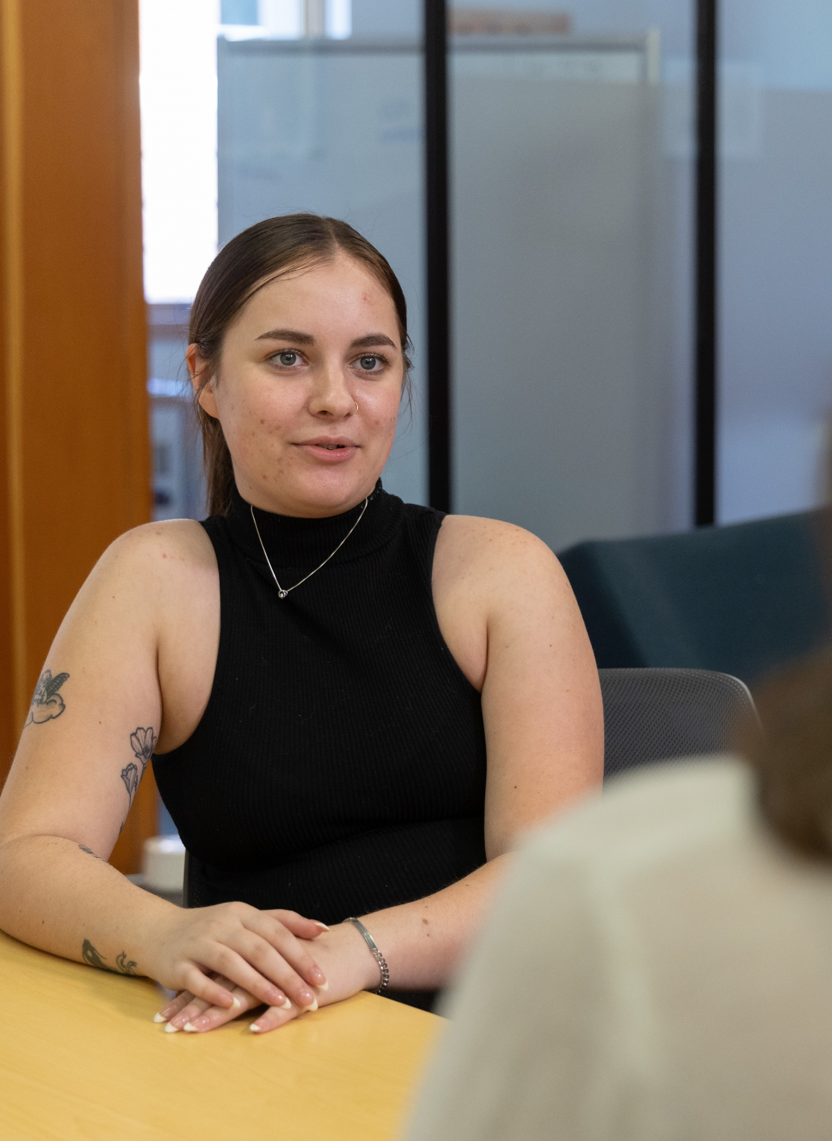
Academic Advising
All students are assigned an advisor in their major and college, or in the University Exploratory Studies Program
New students meet with their academic advisor each term
Advisors work in partnership with students to help them maximize their educational experience, navigate the logistics of earning their degree, and consider their post-graduation options
12

Slide 10

Building Independence Over Time
Strength-based: drawing out and building off of the skills and knowledge they have
Scaffolding: providing temporary support and encouraging independence over time
Facilitative: empowering students vs doing things for them
4
Notes:
I want to shift now from talking about the details of the OSU onboarding and talk more philosophically about the approach that we take to supporting students during the transition. Philosophically we lean heavily on a strengths-based approach – acknowledging that students enter the university with skills and knowledge that they've built in their prior educational environments. While the university setting is an experience that relies heavily on personal responsibility, we recognize that students will need more support early on in their time at OSU and over time we will be able to encourage more independence. We refer to that as scaffolded support providing more support in the short term and then transferring that responsibility to them over time. Finally, we train our support staff to use a facilitative approach which refers to empowering students to do things for themselves and supporting them in that process versus doing things for them sort of shifting from doing for to doing with and then eventual just listening and cheering them on.
I offer this up today because these can be useful mindsets to know about how we approach working with students.
When I train students on facilitation – for example with coaches – we talk about the places that are a good fit for facilitation. Example if you can imagine a student asking me where's the library, they would not gain much from nor appreciate me saying “well where do you think the library is?” that's a piece of information, it's a fact – less useful to facilitate thinking there. I might say “let me show you how to look that up and teach them to use the map or I might say “it’s right over there.” But in an instance where a student has to make a decision or they're trying to figure out the best path forward I believe that students bring a lot of great ideas and a knowledge of themselves and what they need that inform the conversation. So if a students says “I failed my midterm” – I’m not necessarily going to jump in and say “well did you talk to your instructor?” which is both advice and a bit of judgement. I am likely to listen, ask questions, and support their next steps.
We’re going to dive into these in a bit more depth. This approach may be familiar to some of you, and it’s not right for every situation, but when I train staff on supporting adult learners, we focus on this approach as it is empowering and supportive.

Slide 11
Coaching Skills
Open Listening
Facilitative Exploration
Support Follow Through
What are you noticing about ______ (your classes, your adjustment, your stress levels)?
What’s working well for you so far?
What has been hard?
What have you already considered?
Do you have a sense for what you want to do next?
What resources have you tried? Who have you talked to about this?
How will you get started? What’s your first move?
What’s one thing you could do this week to move forward on this?
Who might you talk to for help?
11

Slide 12
Q1
How might you approach one of the scenarios we brainstormed that could be challenging for students?
Discussion
What would be a “directive” approach? (Telling them what to do)
What would be a “facilitative” approach? (Supporting them in finding answers)
5

Slide 13
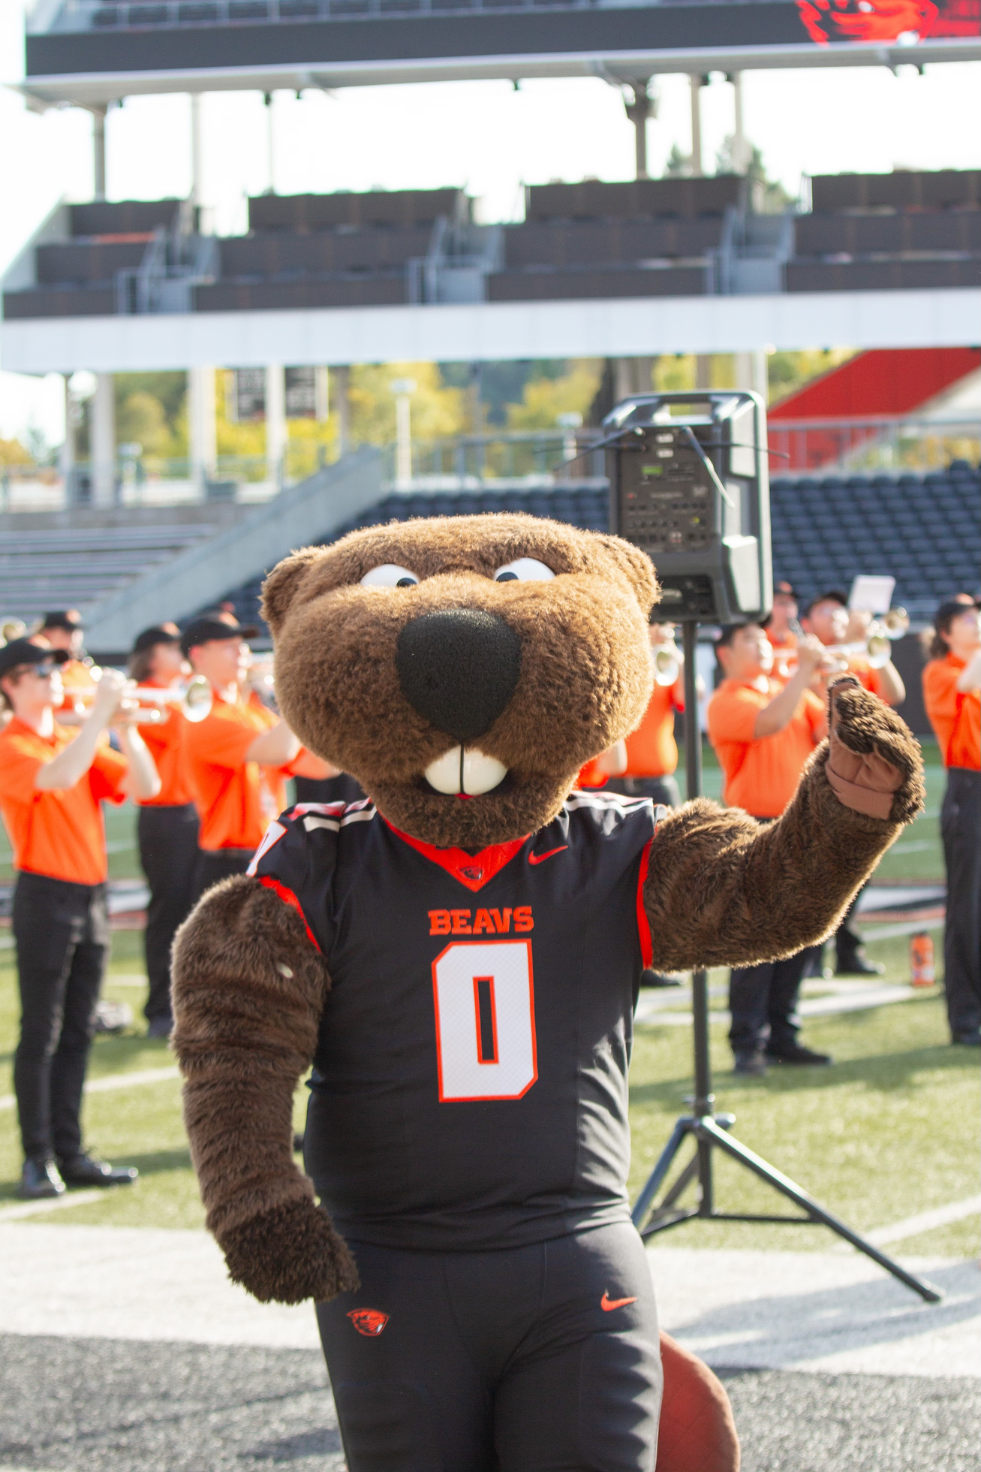
Questions?
12

