Slide 1

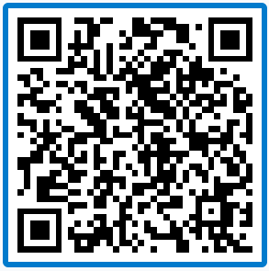
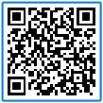
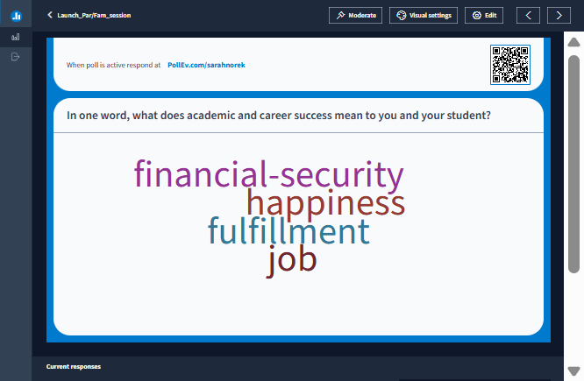
As you settle in, please share:
Notes:
[Note to facilitators: Be sure you log into PollEverywhere first and activate the activity: https://www.polleverywhere.com (in the Launch_Par/Fam_session folder. Also: you may be repeating this as folks enter the room or resettle. Folks may have stepped away between sessions, or might be up and stretching. Use your judgement to determine how many times you invite folks into this activity. We’ll refer back to it when we reach the slide: Success is complex.]
---
Welcome! Thanks for being here with us this afternoon! We’re looking forward to our time together!
As folks settle in and return to seats, please take a moment to add to our word cloud – we’re going to use what you share a little later in our conversation.
You can scan the QR code with your phone’s camera; you’ll have an option to skip registering “for credit” – go ahead and skip it!
Once you’re in, you’ll arrive to an activity that asks you to share, in one word, what academic and career success mean to you and your student. If you need two words you can add a dash between them.

Slide 2

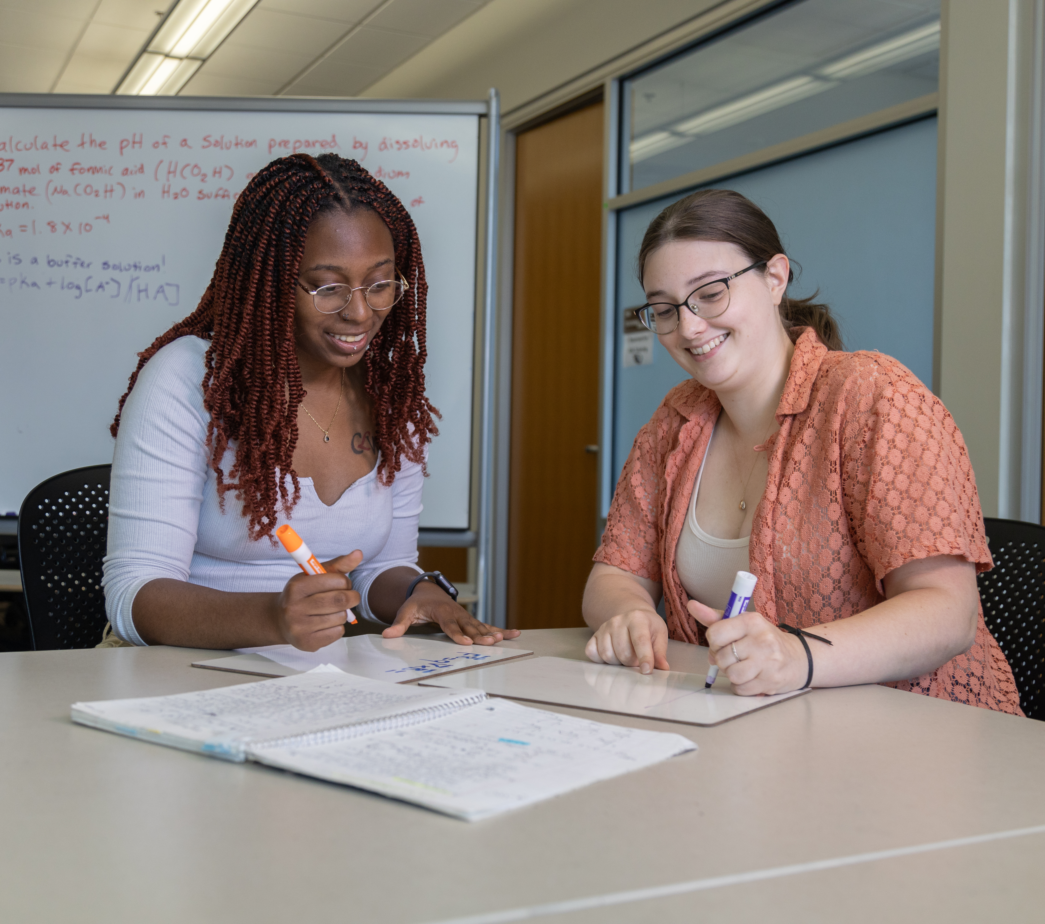



OREGON STATE UNIVERSITY
Academic & Career Skills
for Now and What's Next
Academic Success Center &
Career Development Center

Slide 3

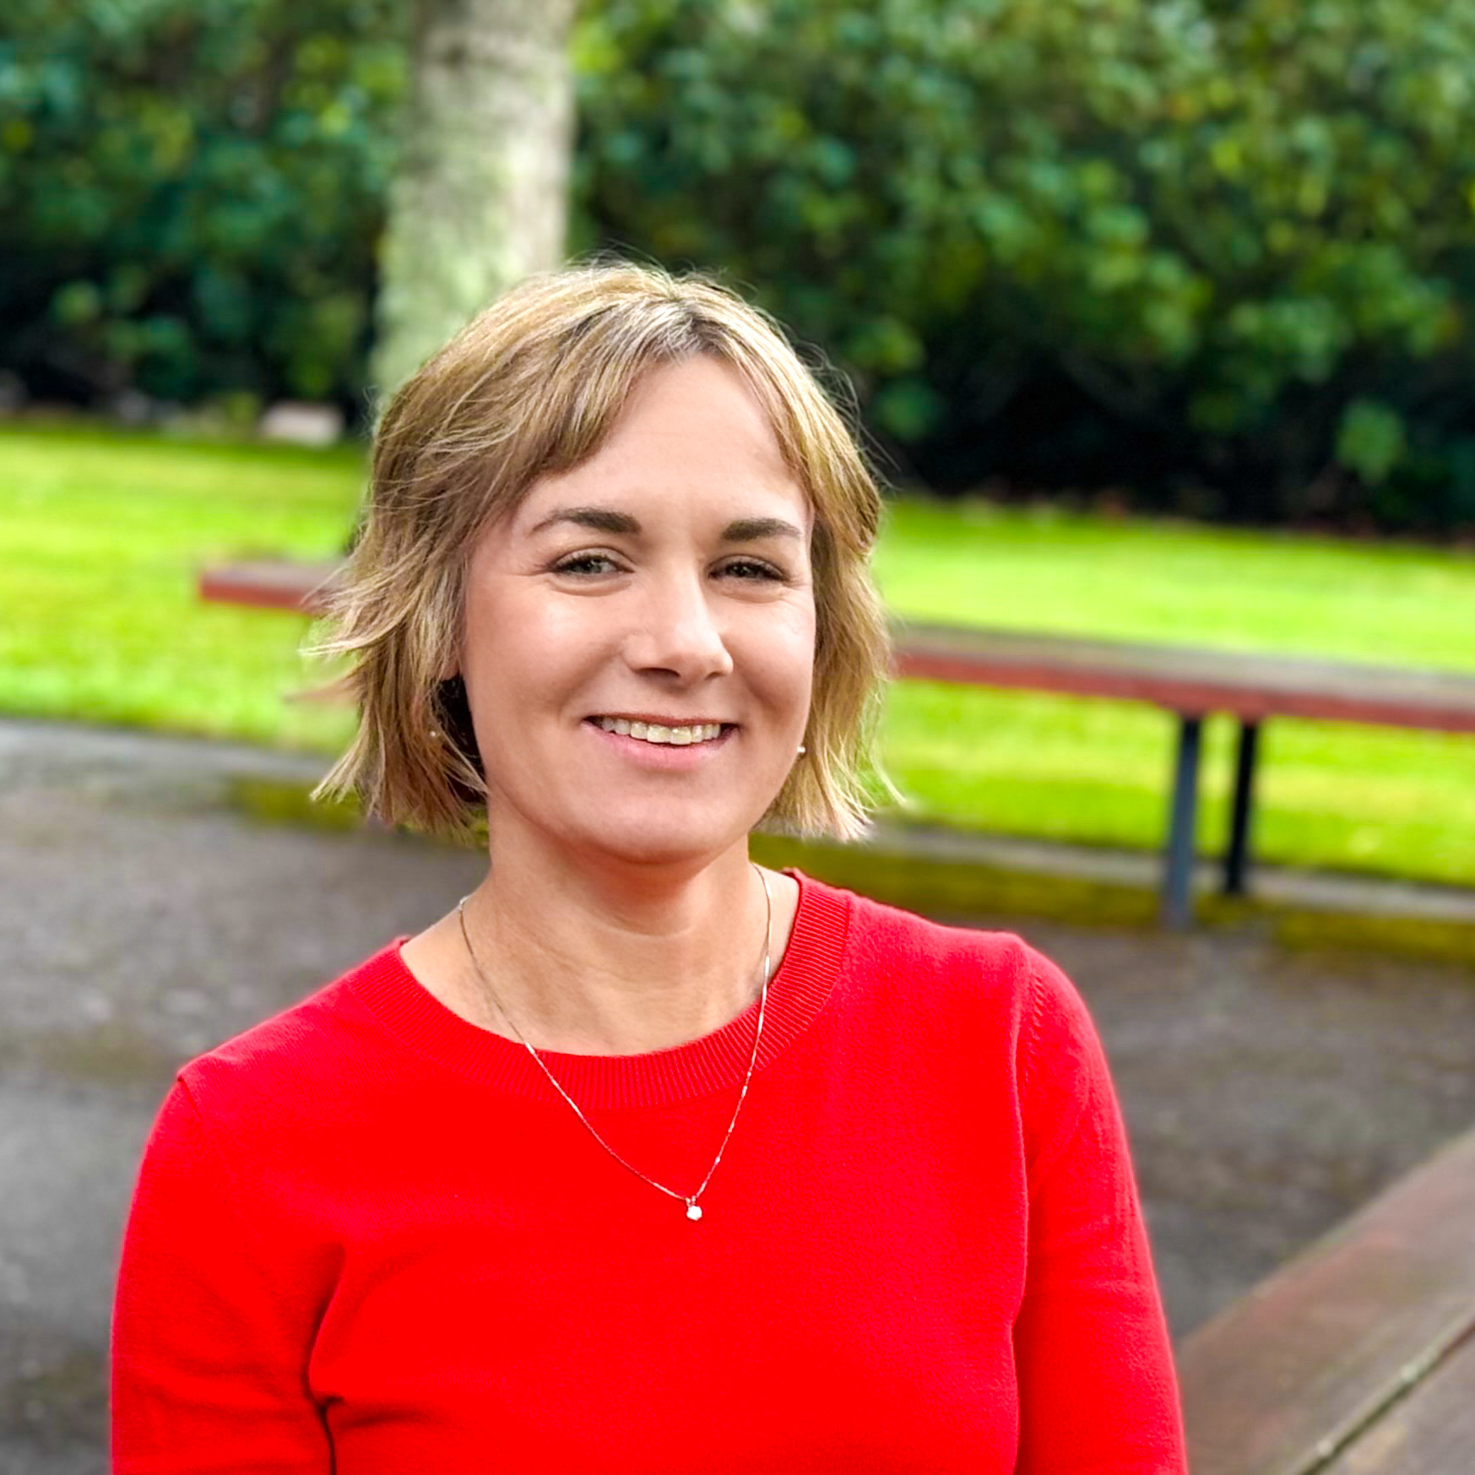
HELLO!
Thank you for choosing Oregon State!
Jen Rouse Career Development Center
Sarah Norek Academic Success Center
Notes:
[Name and title with the Career Development Center
Our office is here to help students develop the career skills and connections that will help them explore and achieve their professional goals, both during their time here at Oregon State, and afterward.
]
Academic Success Center rep
Name and title with the Academic Success Center
The Academic Success Center is here to help all students learn how to learn throughout their time at OSU.
We know folks enter OSU with skills and strategies they've already developed, and we also know that it’s common to adapt and change strategies as courseloads change, course content changes, and opportunities increase that need to be juggled.
We help students develop skills around planning time, studying, overcoming procrastination, communicating with classmates and instructors, working in teams, and more, and all of these skills can support them throughout their time at OSU and into career.
Every student is unique; there’s no one-size-fits-all resource or solution. We meet folks where they’re at, support them in their approach to academics and connect them to campus resources.

Slide 4
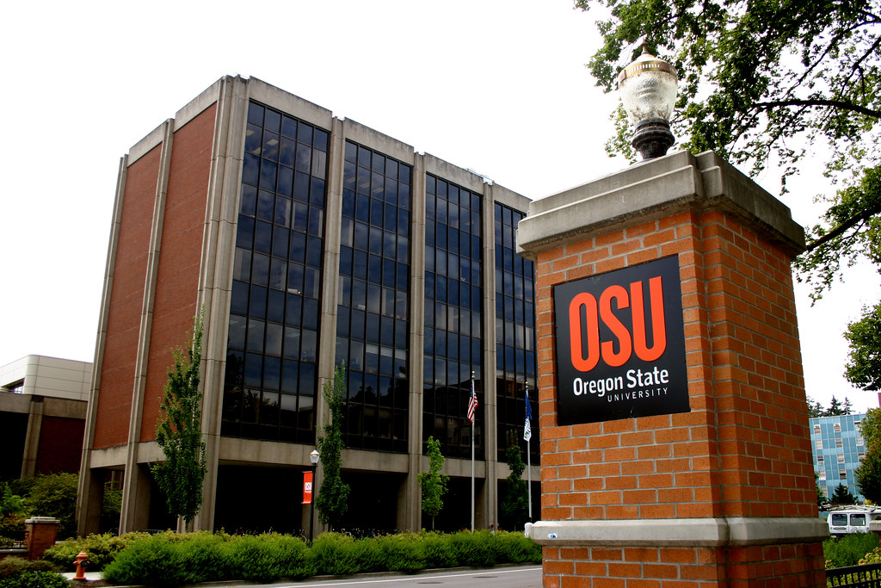
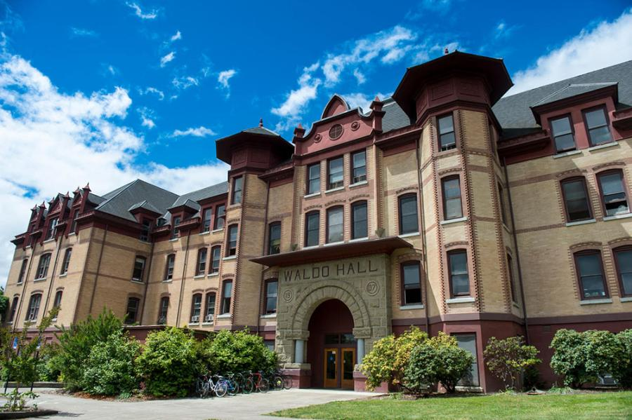
HELLO!
Thank you for choosing Oregon State!
Michal Kawka Career Development Center
Adam Lenz Academic Success Center
Notes:
[Name and title with the Career Development Center
Our office is here to help students develop the career skills and connections that will help them explore and achieve their professional goals, both during their time here at Oregon State, and afterward.
]
Academic Success Center rep
Name and title with the Academic Success Center
The Academic Success Center is here to help all students learn how to learn throughout their time at OSU.
We know folks enter OSU with skills and strategies they've already developed, and we also know that it’s common to adapt and change strategies as courseloads change, course content changes, and opportunities increase that need to be juggled.
We help students develop skills around planning time, studying, overcoming procrastination, communicating with classmates and instructors, working in teams, and more, and all of these skills can support them throughout their time at OSU and into career.
Every student is unique; there’s no one-size-fits-all resource or solution. We meet folks where they’re at, support them in their approach to academics and connect them to campus resources.

Slide 5
Success is complex.
What kind of pressures do you think exist for students to be successful?
Notes:
As you were settling in for this session, you might have been adding to the wordcloud up on the screen. We invited you to answer the question: What does academic and career success mean to you and your student? And we saw some themes in your answers, but we also could see the your answers, too, in that complexity of
There’s no single concept of success for everyone.
Success is complex and means a lot of different things to a lot of different people - your idea of success might not be the same as your student’s. And, that’s okay.
But don’t worry! There are resources here to support your student’s career and academic success.
To get us started, we’d like you to take about 3-4 minutes to turn and talk with the folks around you – if you don’t know each other, share your names and then chat a bit about What kind of pressures you think exist for students to be successful. We’re going to do this relatively quickly – and it will probably get loud in here! When we bring you back, we’re going to ask for a couple folks to share out what came up in your conversation.
Invitation to share: “We want to hear from two people...”
Thanks for sharing.

Slide 6

Our collective goal:
To help students develop skills that will help them be successful while at OSU and after, too.
Notes:
It might feel weird to be talking about careers when you just got here, but most students are here in college at least in part because a career is what they are hoping to get after graduation.
We want to talk about career development now because academic and career skills are actually closely tied together. Academics success is about so much more than understanding the course content. Both academic and career success require students to develop broader skills that they’re going to use in a number of contexts throughout their lifetime.
During our time together today, we’re going to share about how career and academic support show up on campus and in your student’s OSU experience.

Slide 7
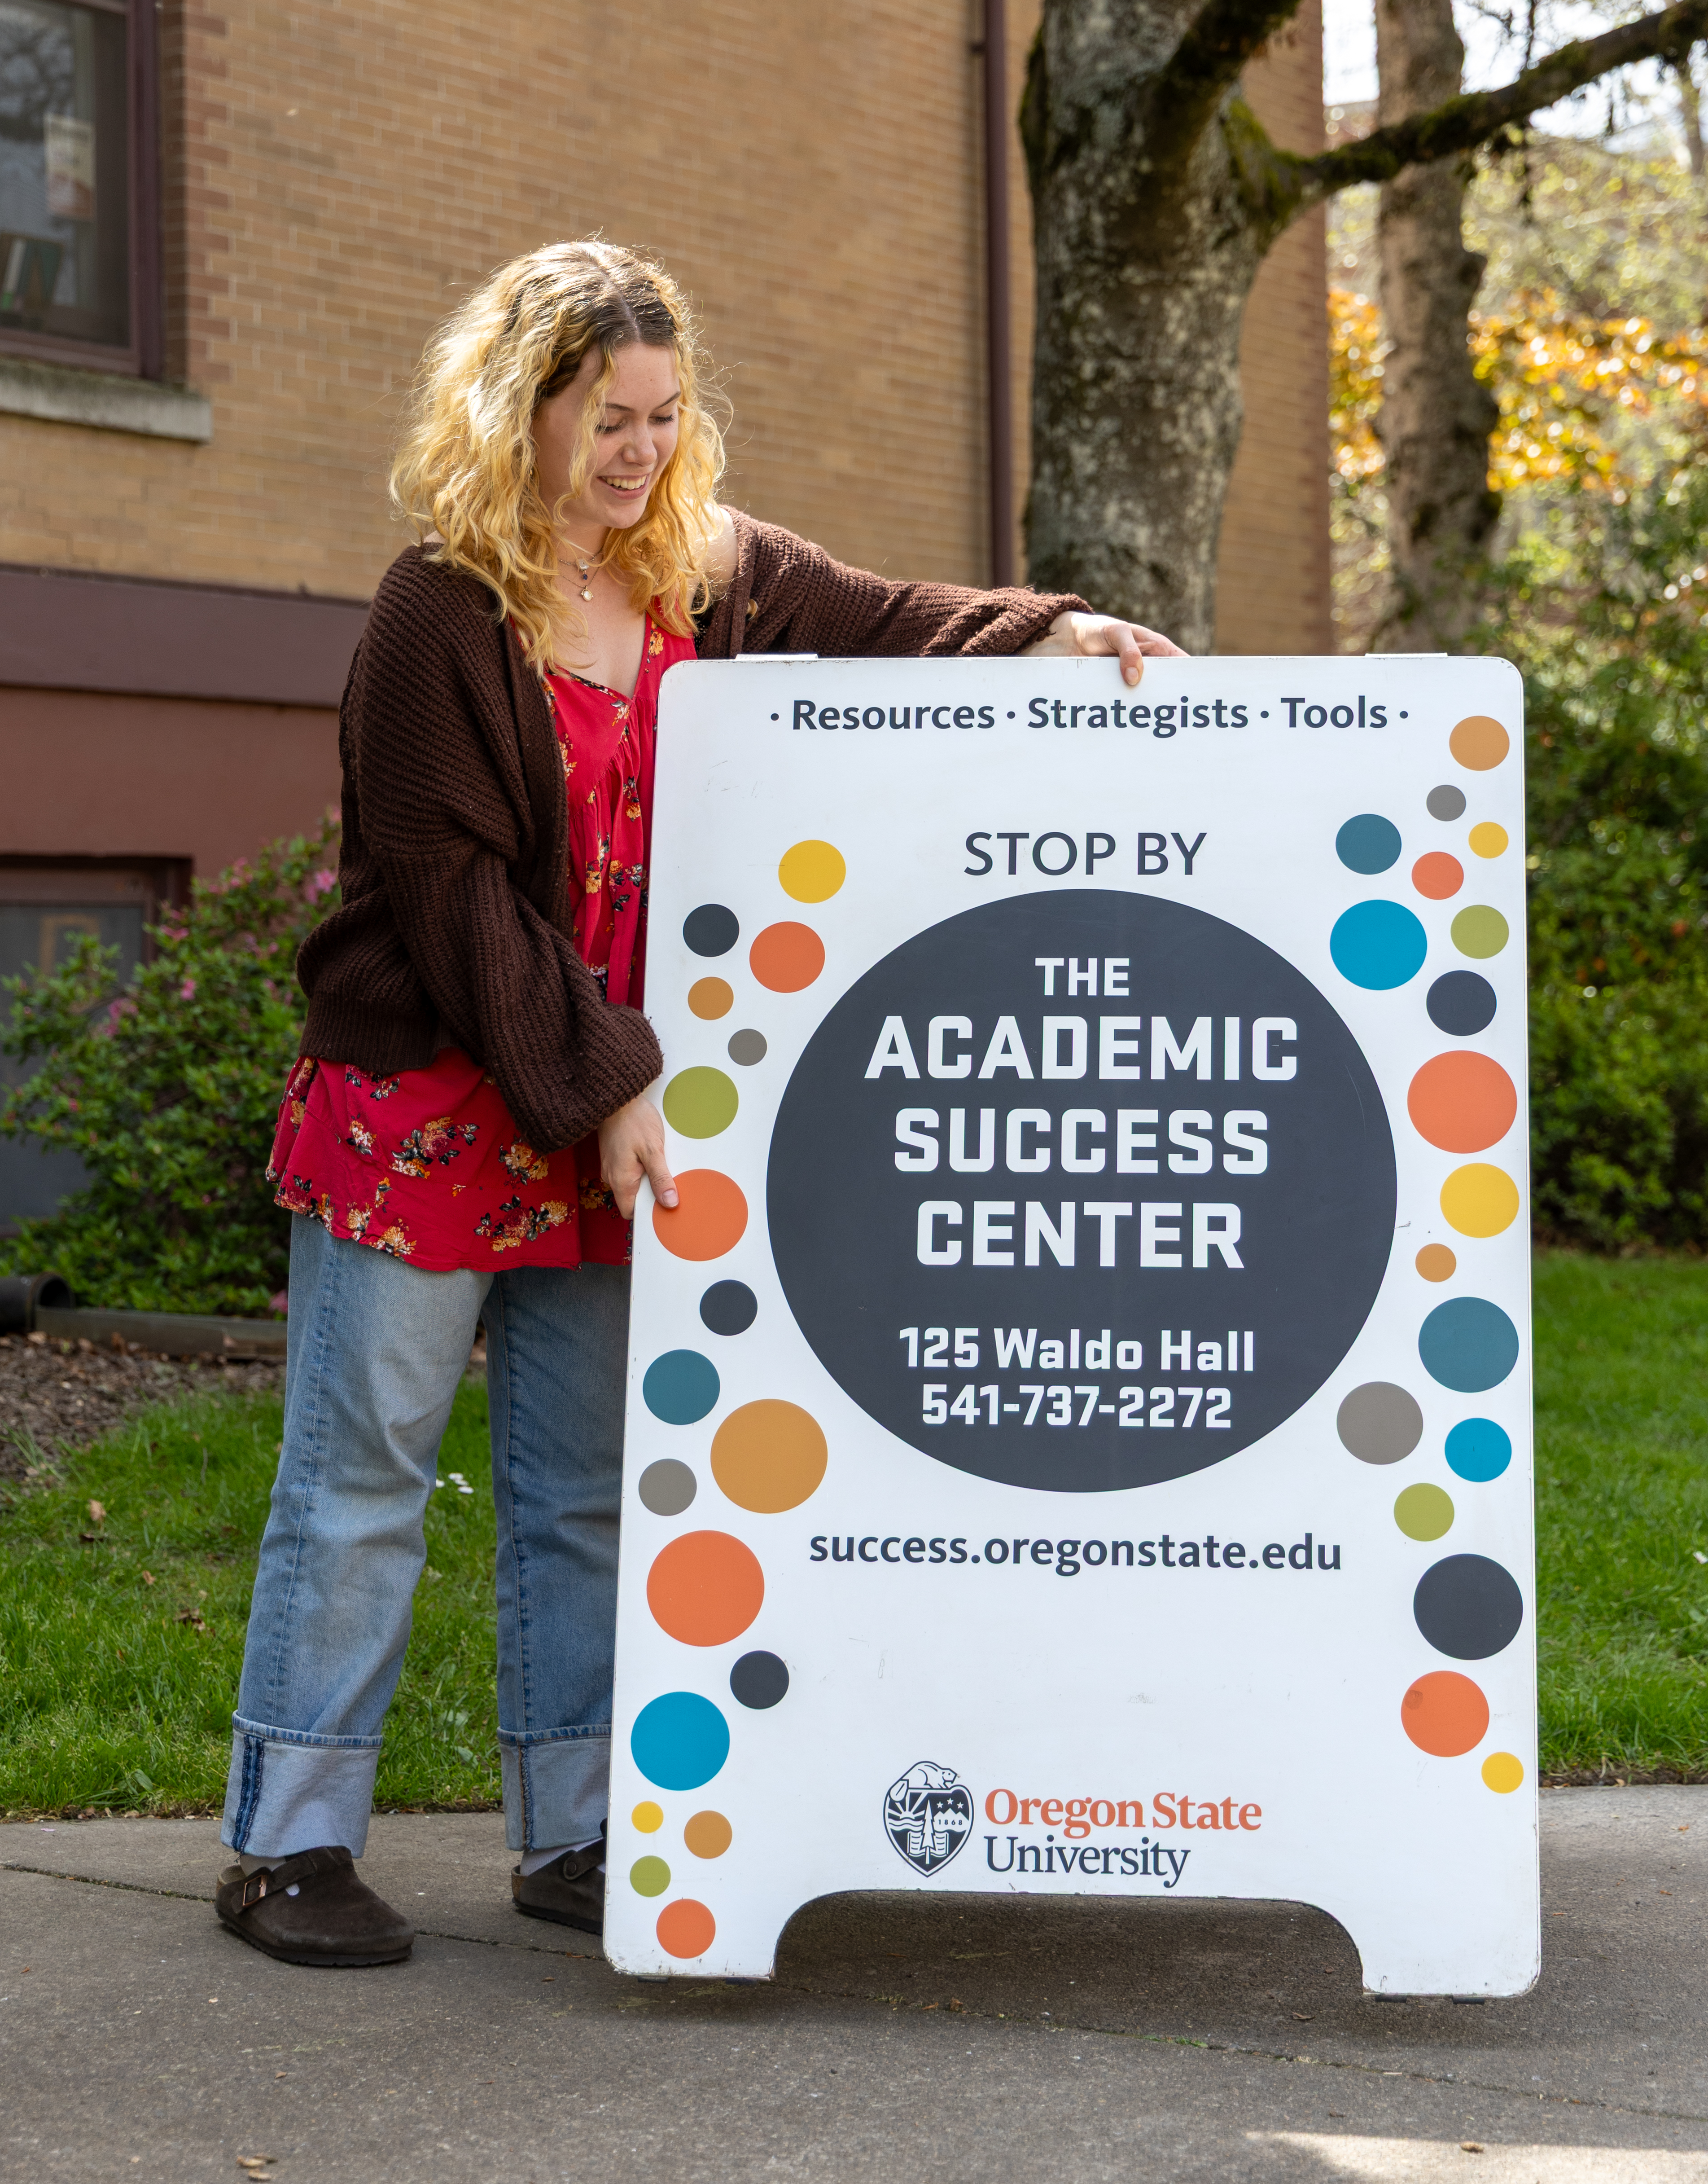
Academic Support Inside & Outside the Classroom
CORE 100/300: Transitions (2-credit course)
20+ student support services
14 college-based tutoring & learning centers
Notes:
First, we want to talk about the breadth of academic support resources at OSU
Academic support takes place inside and outside the classroom. We know that students are here to learn, and that learning how to learn is a process for everyone – including ourselves!
Every student will be learning in every class they take – content learning, how to be in discourse, how to think critically about the information they’re engaging with, how to engage in a group setting, how to ask for help and take initiative and so much more.
These are experiences and skills that will be directly applicable to their time beyond OSU too, in their career. And, we know that as many strategies and skills as students are bringing in, they will have to learn and adapt to this university context.
To support the transition into the university environment, beginning this fall, all students will take the CORE 100/300: Transitions course and will engage in content that invites skill development in planning, resource use and more.
These will be taught as lectures and will include small group recitations to support connection and community building with the classroom.
In addition to what they learn and explore in coursework, there are a number of academic and career resources students have access to at Oregon State! With over 20+ different student support services on campus, and an additional 14 college-based tutoring and learning centers, if your student isn’t sure where to go, the Academic Success Center can help connect them to the resources relevant to their needs.

Slide 8
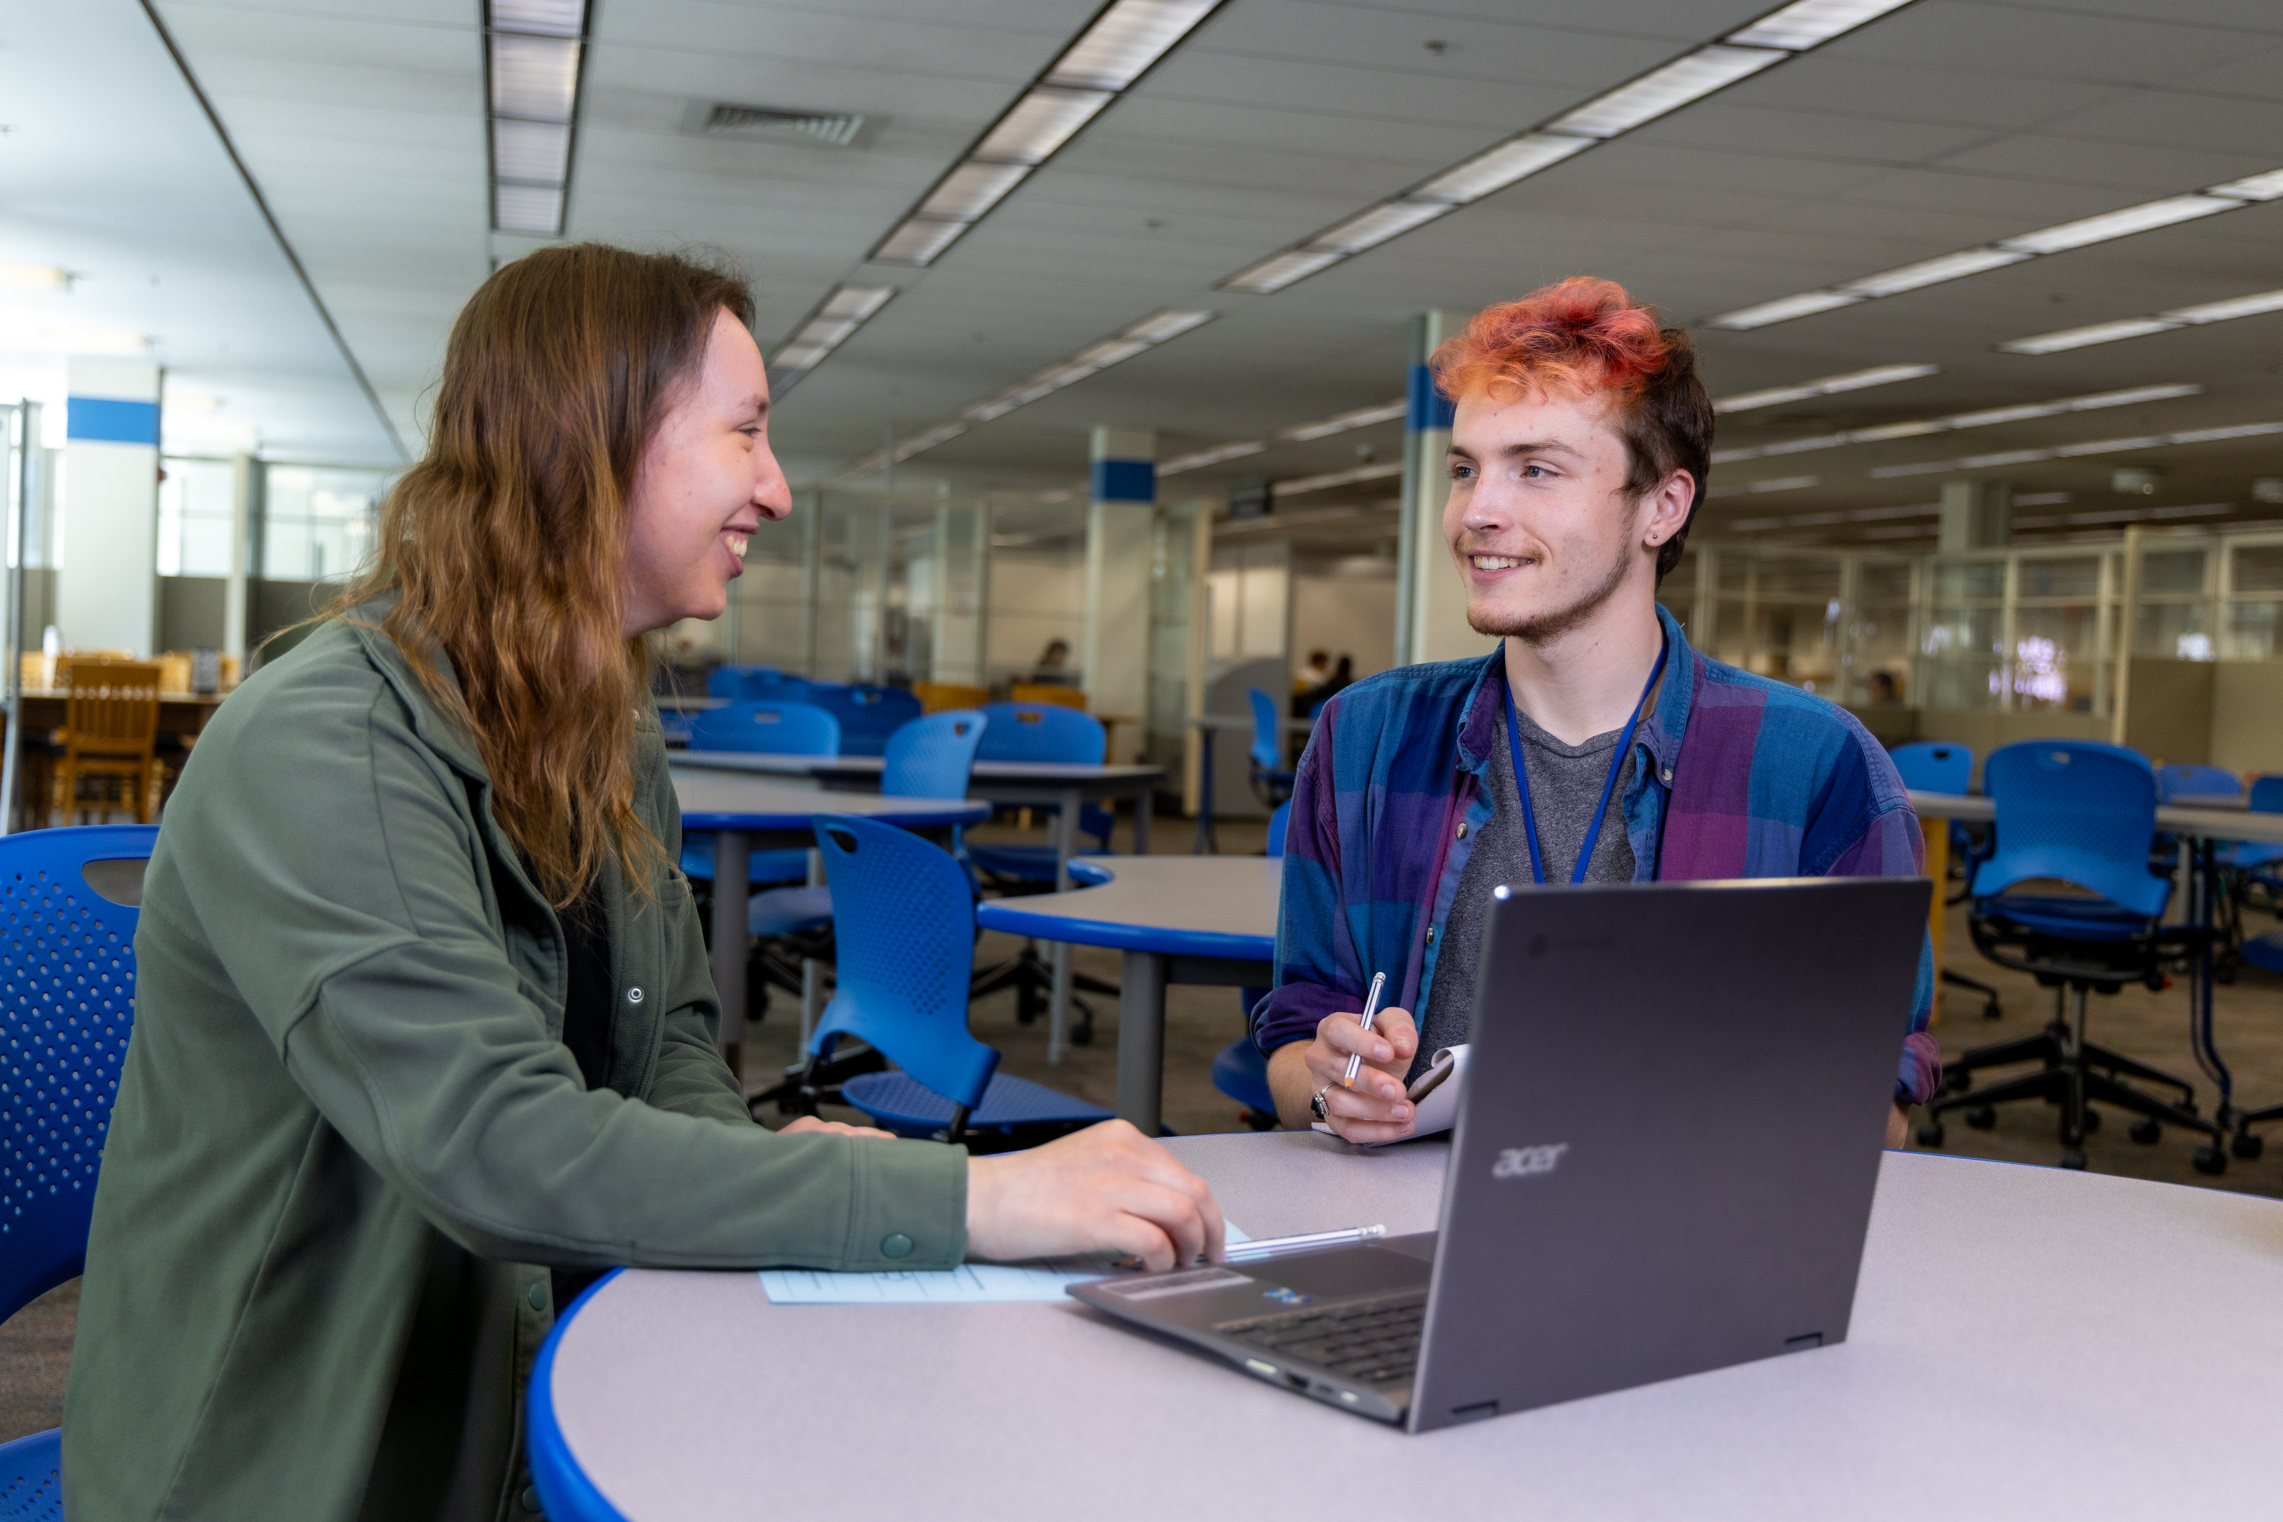
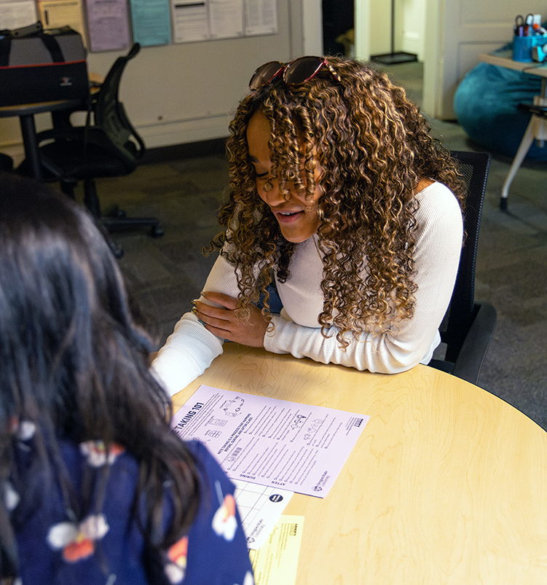
Consultants in the Writing Center support students in developing writing skills.
Strategists at the Academic Success Center introduce students to learning strategies and tools.
Notes:
When we talk about upwards of 40 resources to support students in their academic progress and success, we’re talking about different types of resources within the overall landscape of support. Some resources, like Writing Center and academic coaching, focus on building lifetime skills like planning and prioritization, reading and writing, and communicating across contexts with classmates and instructors. For writing support, students can visit the Writing Studio in the Valley Library, meet with a consultant over Zoom, or submit their writing online for written feedback. When students meet with writing consultants and academic coaches, they engage in conversations to develop skills that will not only help them in their classes but also increase their confidence in learning, writing, and working through challenges.

Slide 9
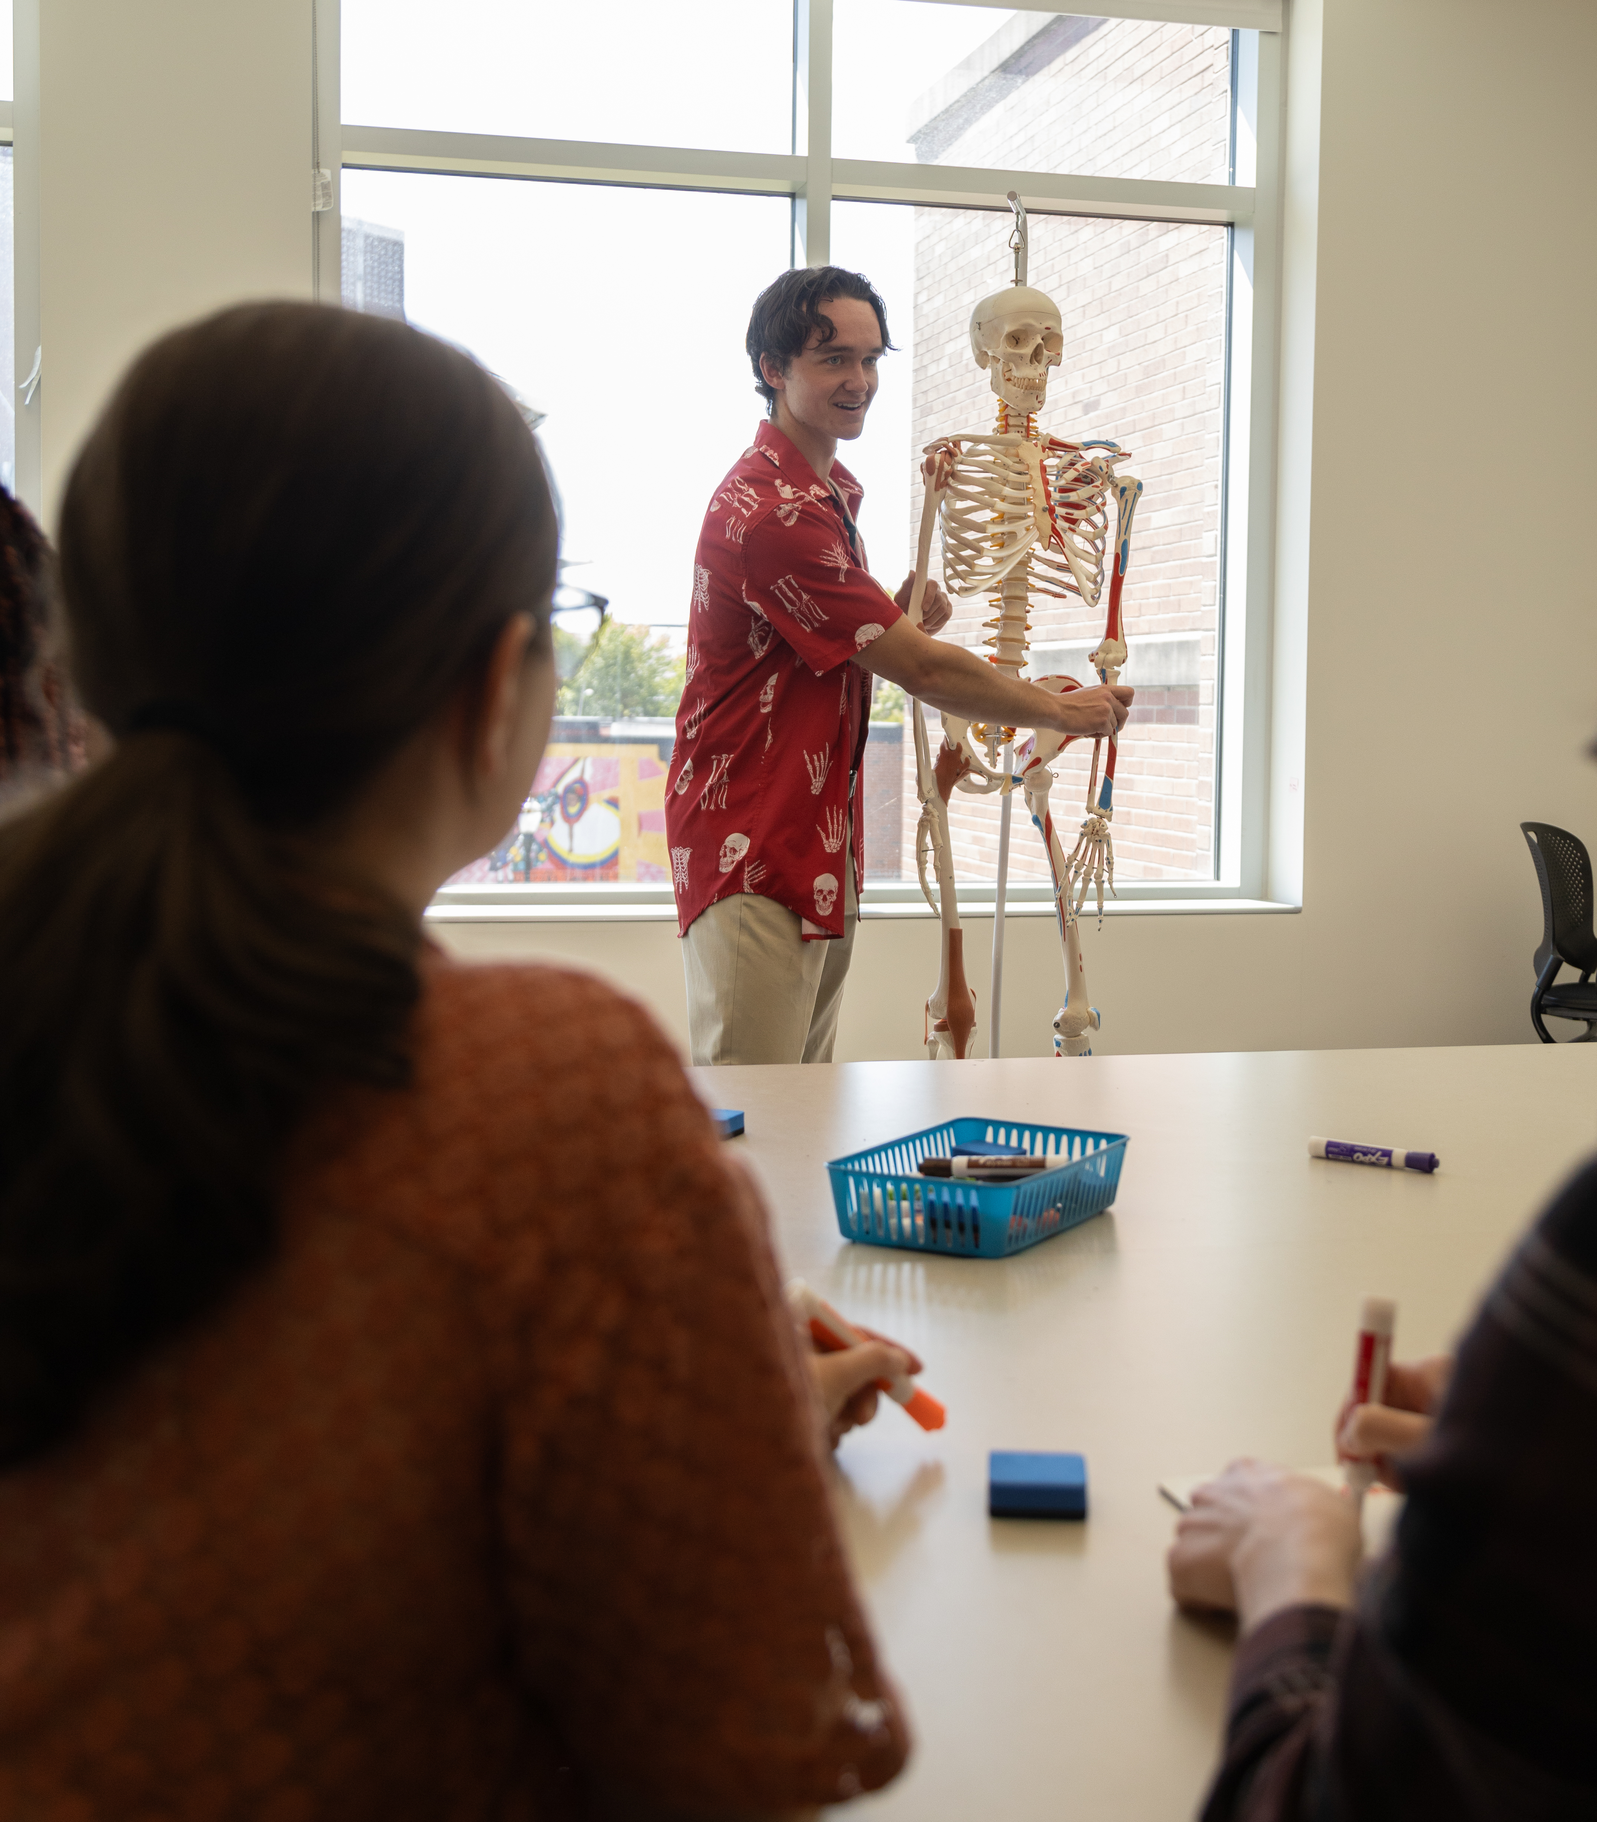
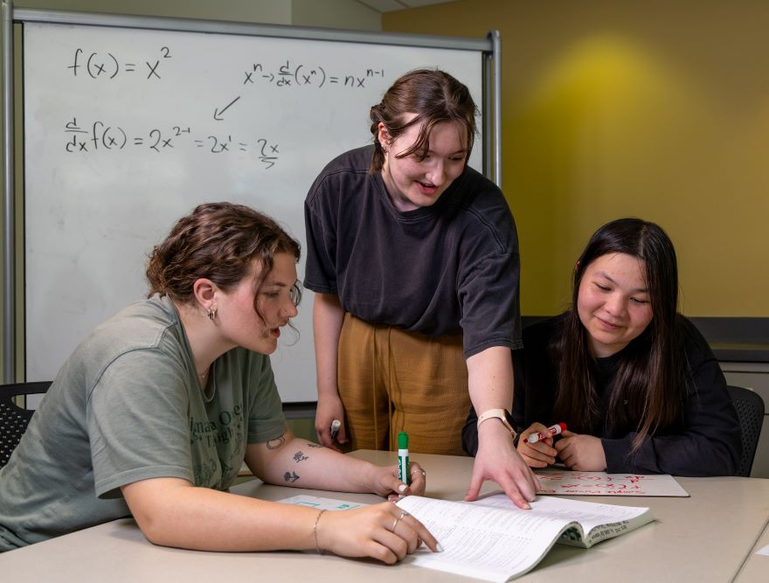

Supplemental Instruction offers weekly group study tables for historically challenging courses.
Notes:
Other resources, like Supplemental Instruction and content-specific tutoring centers (like the Math & Statistics Learning Center, the Mole Hole for chemistry, and the College of Engineering Peer Tutoring Program), focus on helping students understand specific course content and identify strategies and approaches for learning course content more effectively. Nearly all of OSU's academic support is peer-to-peer, which a lot of students find more comfortable, making it easier for them to get the support they need.

Slide 10
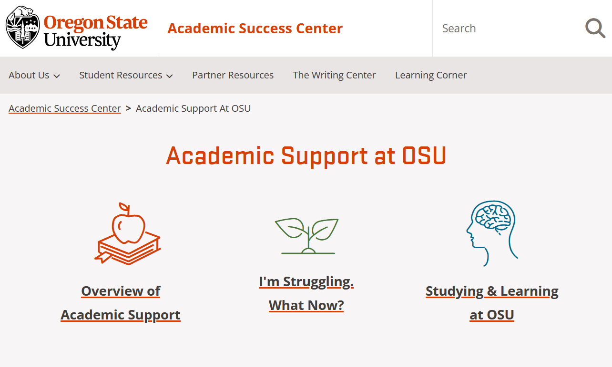
Academic Support at OSU
Students can explore
academic support resources
what to do if they're struggling
how to build their skillset for studying and learning
beav.es/academic-support
Notes:
Like we mentioned when we began talking about academic support at OSU – the Academic Success Center can help students locate resources and support on campus. OSU is a large university with a lot of resources, and we at the Academic Success Center want to make it easy for students to get connected to the support they need. This means folks can drop-in to our space in Waldo Hall room 125 to get tailored referrals to resources. But we also know folks might need to find support outside of our business hours, too. Learning and challenge doesn't just happen from 9am to 5pm!
To help students in these moments, or for folks who want to explore online on their own first, the ASC hosts an Academic Support at OSU webpage, which connects students to tutoring and college-based resources, as well as information about what options are available for students who are struggling and how students can build their skillset for studying and learning.

Slide 11
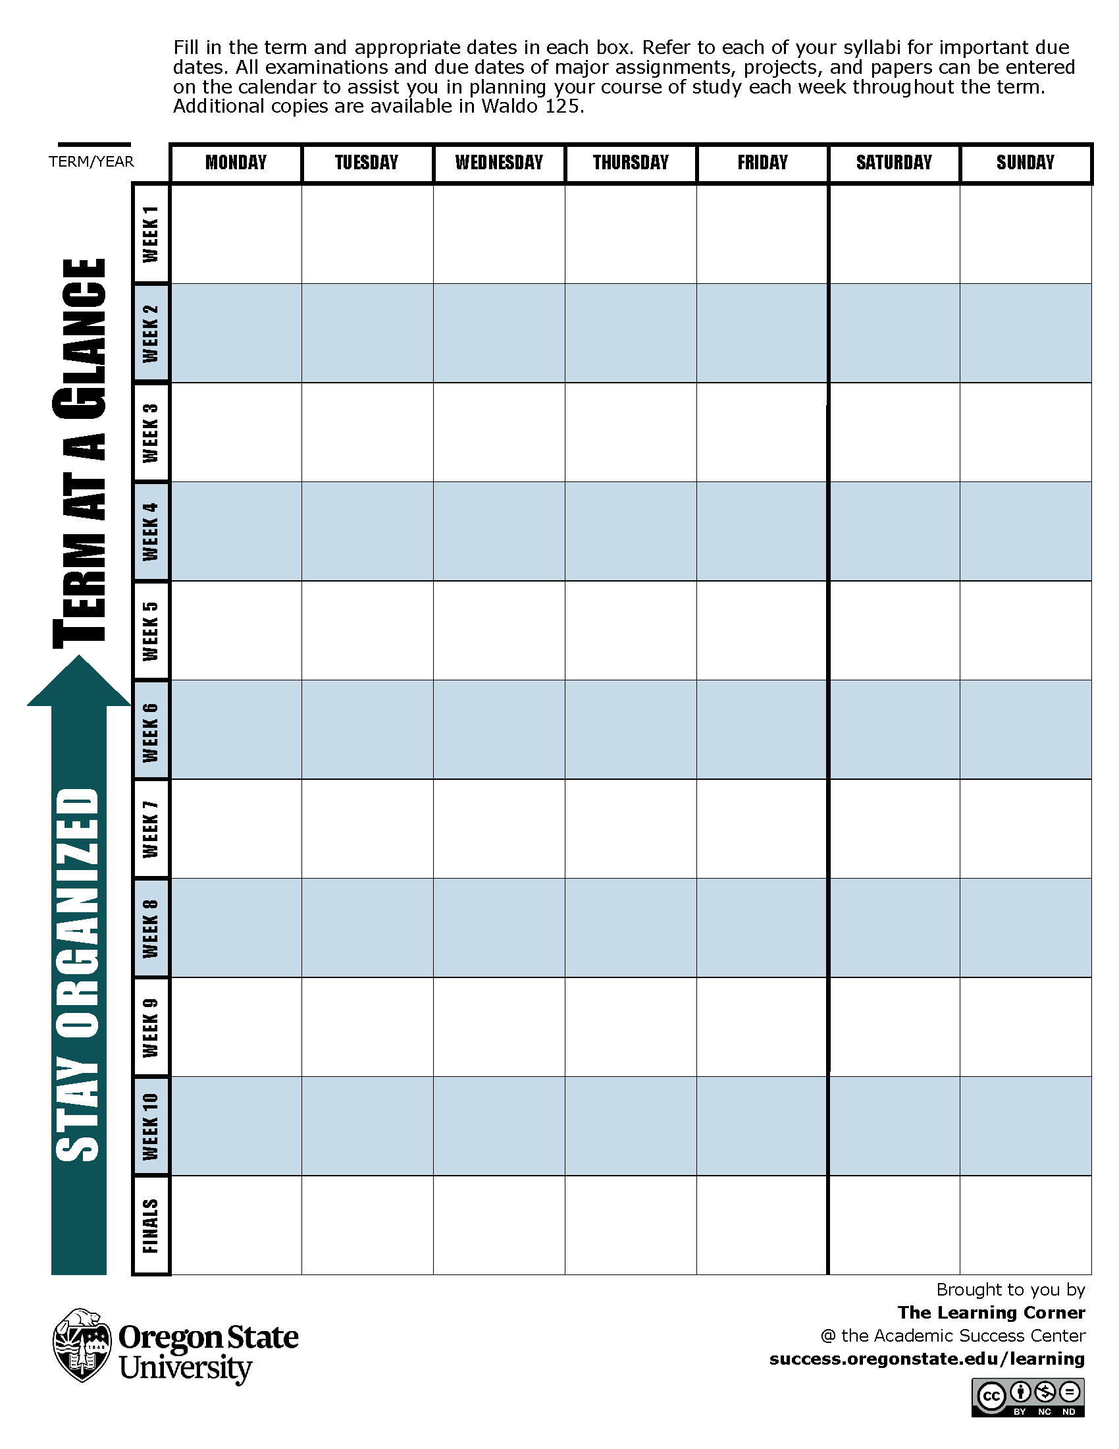
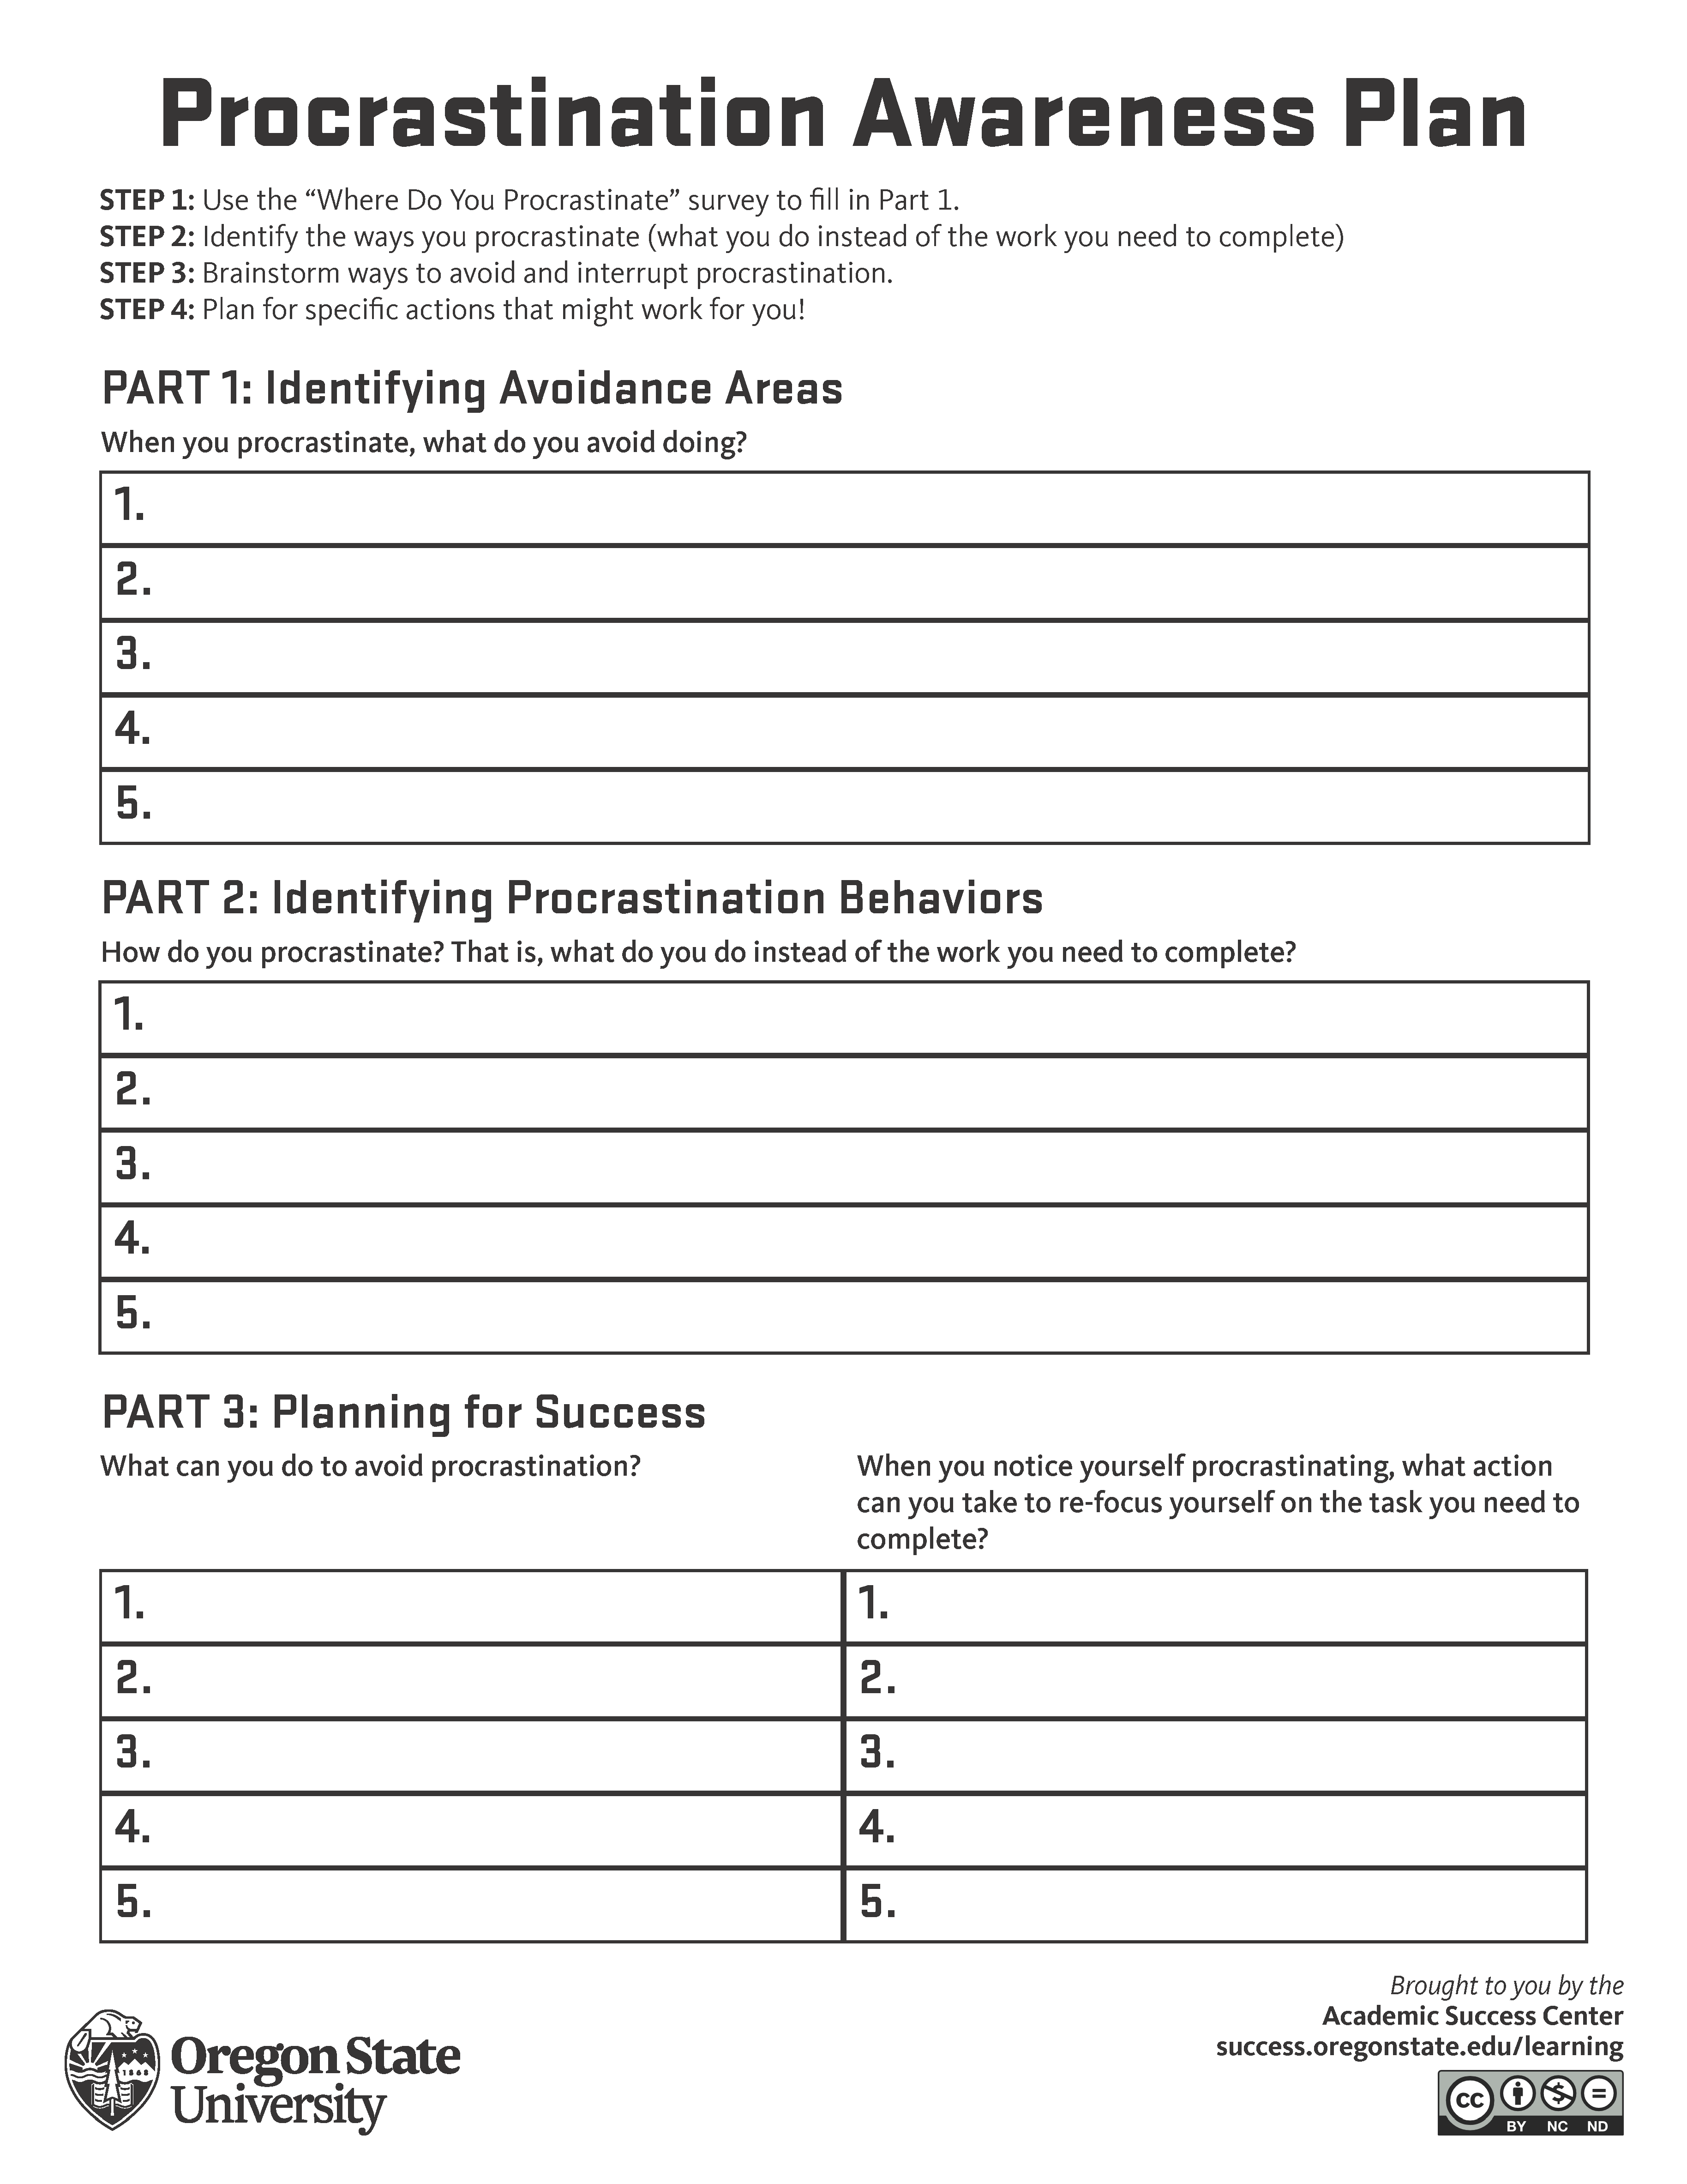
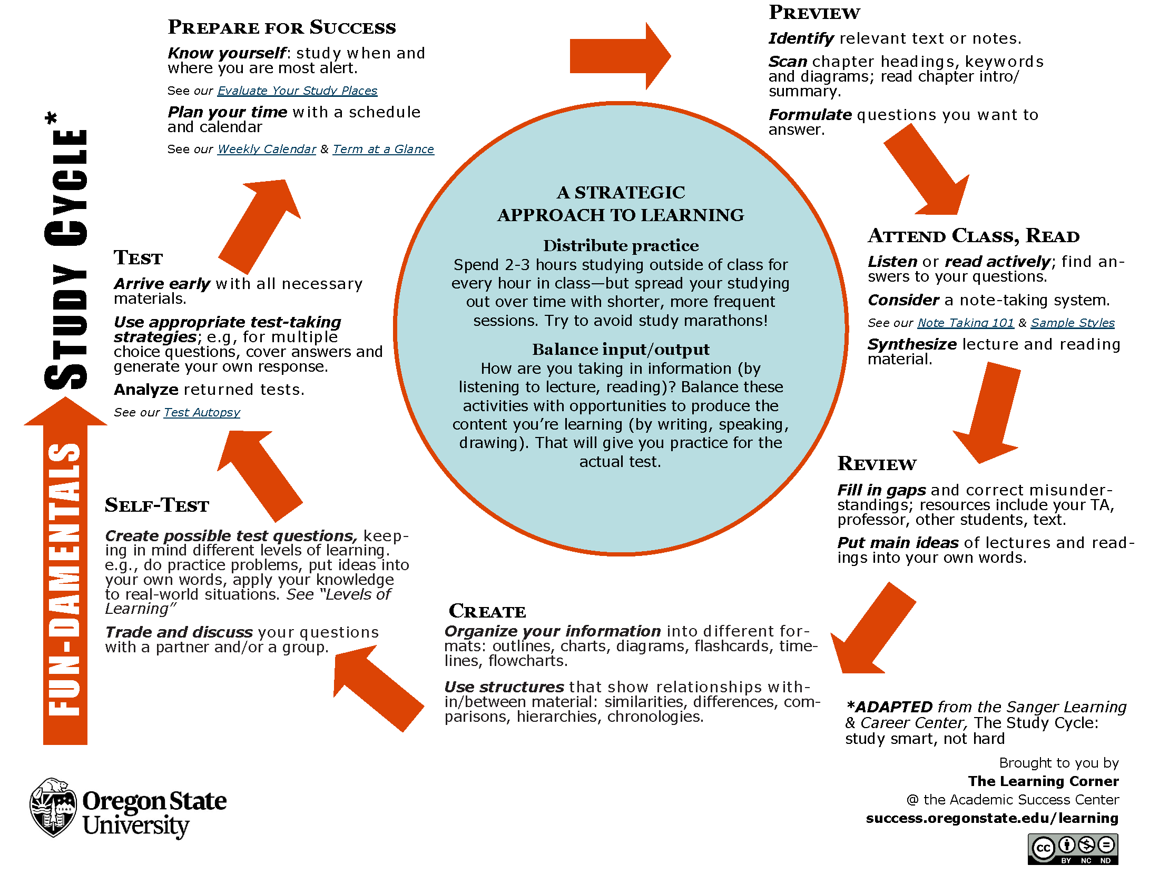
The Learning Corner
beav.es/learning
Notes:
Another great online resource for students is the Learning Corner, which is our collection of articles, handouts, and interactive tools based in the science of learning. All of our Learning Corner content fits within broader themes of planning time, studying, reading & writing, procrastination & motivation, test-taking, and balance & stress – so those really foundational, core transferable competencies that students need to be successful both in an academic and career setting. A lot of our Learning Corner handouts and tools are physically located in the Academic Success Center, the Valley Library, and other places around campus, and of course fillable PDFs are available online as well for students' convenience.
At the Academic Success Center, it’s really common for us to work with students to help them identify and try different planning tools and strategies. ASC Strategists will chat with students about how they plan their day, their week, and their term, offering resources for students to select from and try. We have lots of different strategies and tools to share because we know that everyone is different. What works for one person might not work for another, so there's no "one size fits all" approach. Planning is an extremely important skill for students to practice and develop over their time at OSU, and they'll be taking their planning skills with them to their future jobs, internships, and research. Trying different approaches and techniques – for their coursework, to juggle school and job and extracurriculars, to create a balanced schedule that holds time for wellbeing practices and activities – gives folks experiences they can talk about later, during interviews. And again, the Learning Corner isn’t just about planning – it’s got so much information on effective learning strategies, how memory works, how to navigate stress, and more. All of these are skills and strategies that can be applied to their future career, too.

Slide 12

100%
Every student develops career skills and connections to help them explore and achieve their goals.
Notes:
OSU CDC’s Mission: Transforming Oregon State into a leading career-centered university. Vision: Through their Oregon State experience, every student develops career skills and connections to help them explore and achieve their goals.
Draft script – a starting point for the presenters. We encourage presenters to adapt it as they see fit.:
At Oregon State University, we are committed to supporting successful career outcomes for every student who studies and learns with us. That commitment is not just aspirational, but as you will see in the following slides, it’s integrated across all aspects of the university.
Our newly developed mission clearly states that every student at OSU develops career skills and professional connections necessary to explore and achieve their career goals. Among many other areas of distinction, we are a leading career-centered university.
Career Support Now, what does that look like in practice?
For many students, it means preparing for and securing employment in their chosen field after graduation. For others, it may involve pursuing graduate or professional studies. Some choose to serve in the public, nonprofit, or private sectors, and for students, this means launching their own ventures and startups.
In fact, when we look at our alumni, we see Beavers contributing across the globe in every sector of the economy and in almost all types of organization.
Career Support – Four Pillars On the next slide, I’ll walk you through the four key pillars that guide our work in supporting every student’s career development, but first, I let me highlight one important value we hold as a university.
Technical + Transferable Skills We are committed to preparing students not just with technical, domain-specific knowledge, whether that’s in accounting, engineering, public health, or social sciences, etc, but also with transferable skills that are universally valued in the world of work.
We call these transferable competencies, skills like communication, teamwork, problem-solving, and leadership — that apply across industries and distinguish our graduates in a competitive labor market.
Industry-Informed Programming To that end, the Career Development Center, along with partners across the university, stays closely connected with employers and industry leaders.
We regularly seek input on evolving workforce needs, the skills and qualities employers are actively looking for, and we use that insight to design our programming, our events, and services.
Optional example:
For example, our office was one of the first career centers to offer career guidance and programming on the use of AI to help students prepare for the evolving expectations from employers on how to interact with that technology in the workplace.
National best practices
Our work is grounded in national best practices and aligned with real-time labor market data. We are continuously evolving to make sure that OSU graduates leave with a highly valued degree and also with the confidence, preparation, and support to succeed in whatever path they choose.

Slide 13




Career Support
Career-Relevant Curriculum
Tailored Career Support
Employer & Alumni Networks
Connected Co-Curriculars
Notes:
Career Relevant Curriculum: Oregon State serves as a national leader by infusing career development into its curriculum. OSU students take one or more career courses focused on the tangible and transferable skills they will need in the workforce, the career documents that will help them get there, and the experiences that will pave the way. Faculty and staff have the training to confidently support students in this learning. Tailored Career Support
OSU students have access to career services that are not one-size-fits-all, but are specific to their field of study; each of OSU's undergraduate colleges has dedicated career support services.
Employer & Alumni Networks
During their time at OSU, students have the opportunity to build relationships with people who are already working in the fields they're dreaming of. When they graduate, students have a network of professionals they can turn to for advice and connections.
Connected Co-Curricular Activities
100% of students engage in outside-the-classroom learning such as internships, research, study abroad, volunteering, and student jobs – and they know how those experiences are connected to their future.

Slide 14
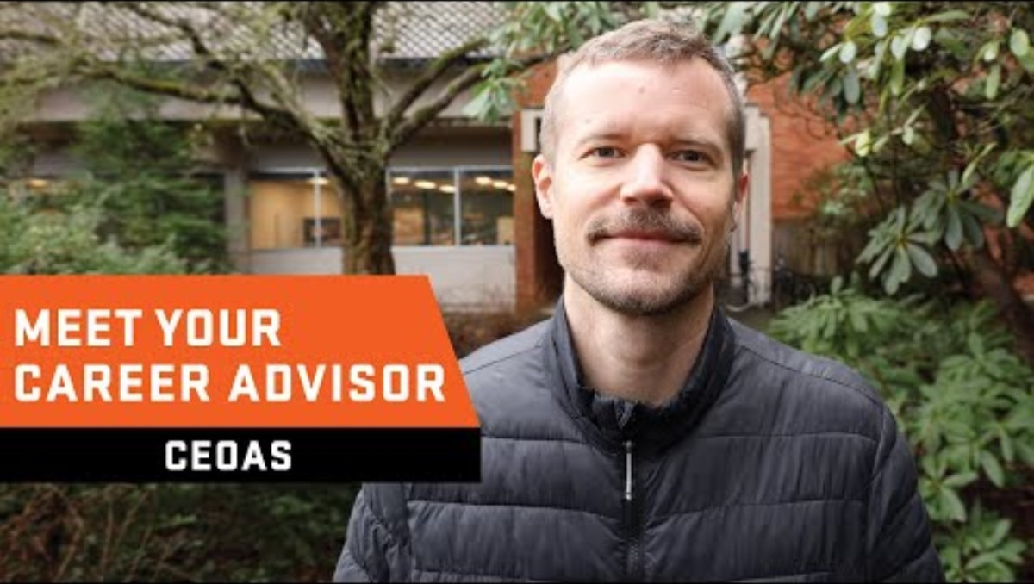
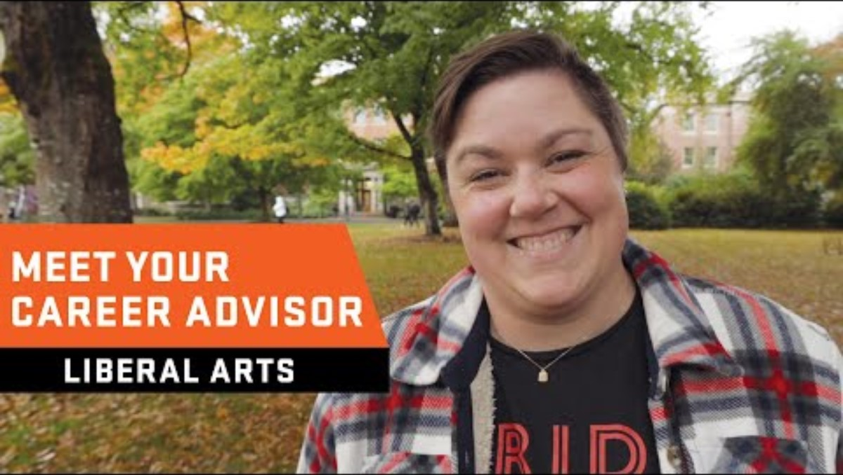
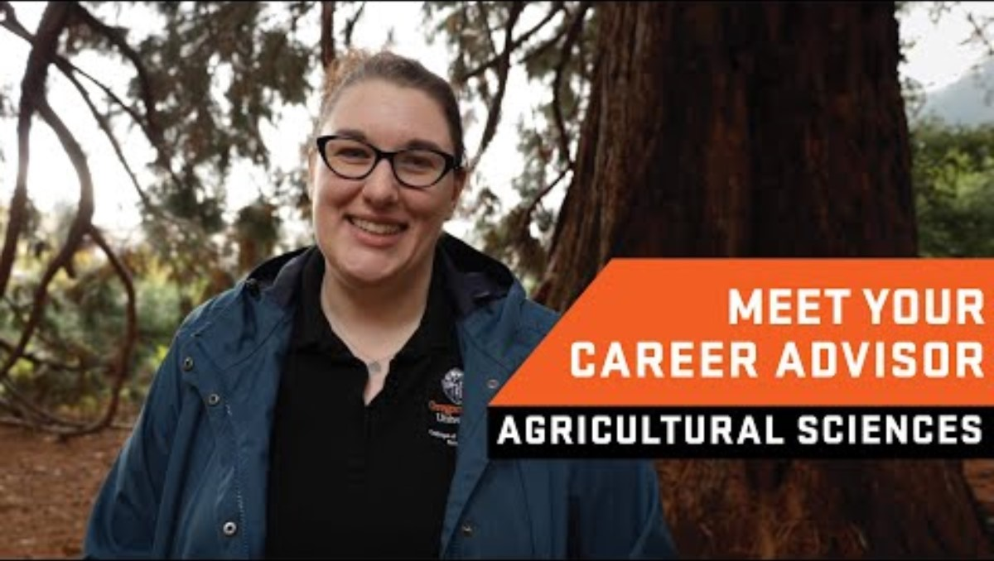
Notes:
The intent here is to play a video by one of our career advisors to make the presentation a bit more engaging and to bring one more voice to the presentation.
Example of Tailored Career Support – Feel welcome to swap videos based on who the presenter is. CAS: https://youtu.be/f33tK6yJTkk COE: https://youtu.be/JMMAw_pDfvQ CLA: https://youtu.be/lAoXNsp3juM
COH: https://youtu.be/Lv8AV5i0tDc
COS: https://youtu.be/dApSpQQJdTo
COF:
CEOAS: https://youtu.be/7RB9U09JmNg

Slide 15
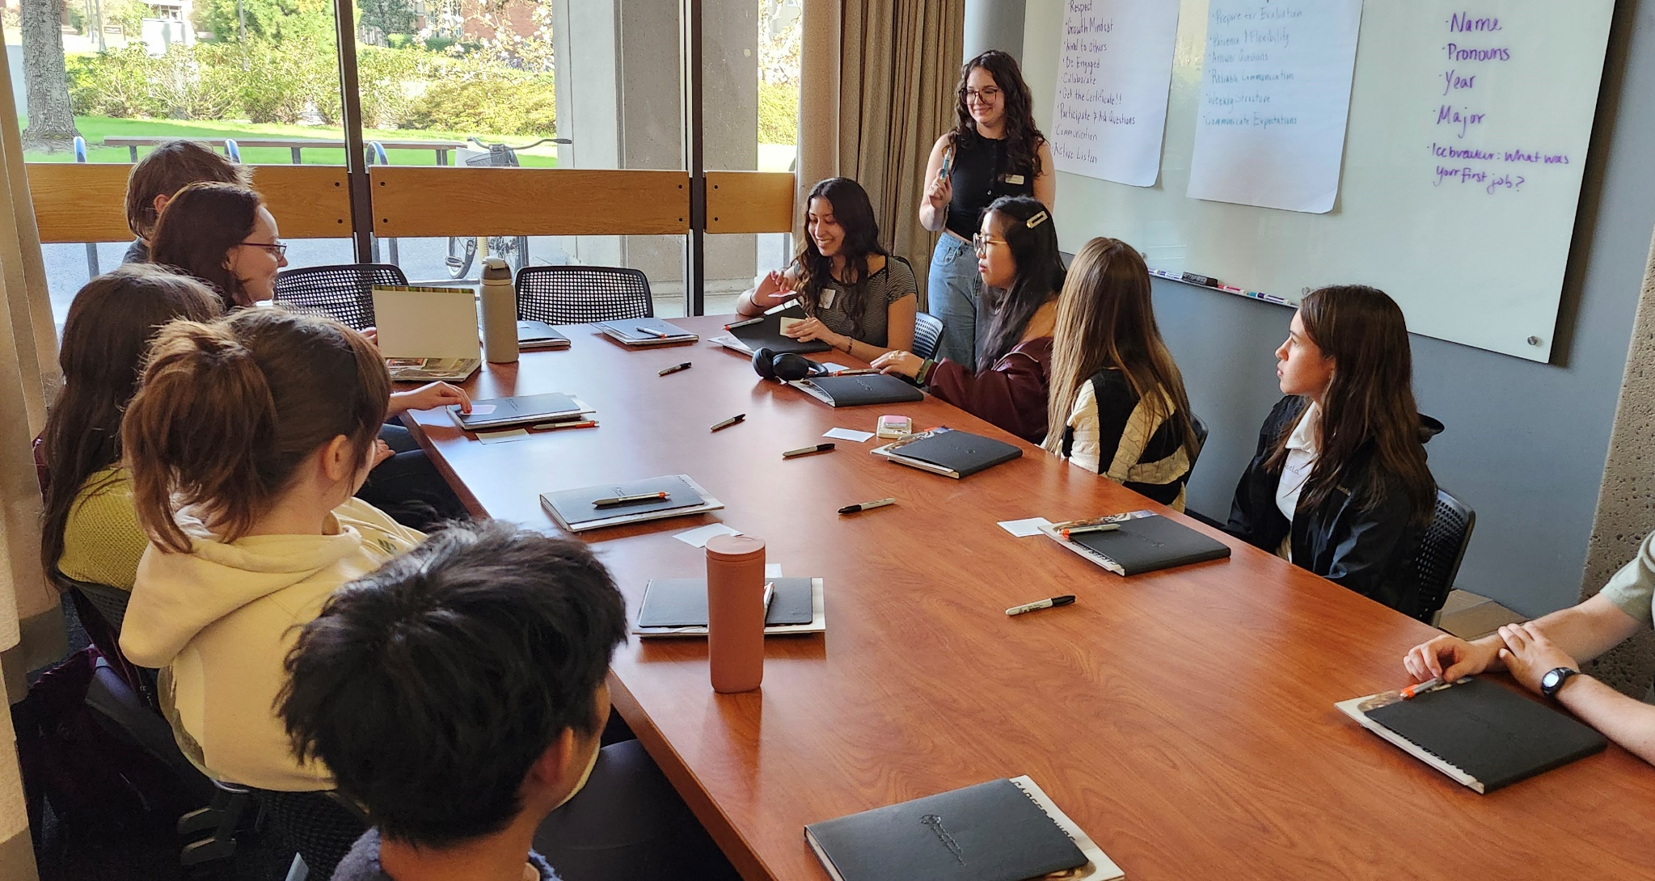

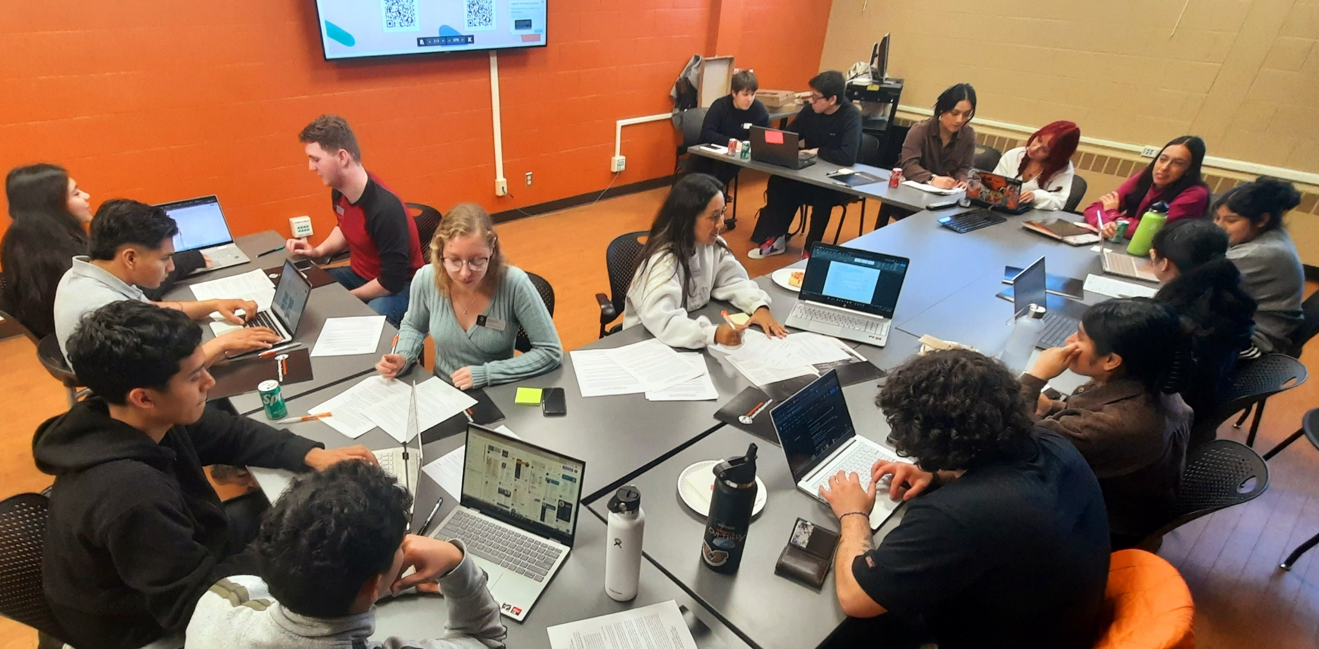
Notes:
The goal here is to show examples and emphasize the holistic and integrated career support from career fairs to clubs and student employment.
Examples of career fairs, workshops, and group resume reviews. Connected Co-Curriculars – Career Assistants, Student Clubs
23+ career fairs
80+ career events with industry partners a term
1:1 advising with professional staff and peers
400+ clubs / Research opportunities / Student employment

Slide 16

How did you support your student in utilizing academic and career resources?
"I worked with my kid to broaden his understanding of what advising meant. Sometimes students think academic advisors only remove holds or select classes, but they are critical resources who can really help students get their footing. In Engineering, advisors can often be the gateway to internships and professional opportunities and help students understand how to take advantage of those opportunities..."
Notes:
Story/quote slide [introduce and read quote]

Slide 17
How did you support your student in utilizing academic and career resources?
"...Second, the Learning Corner is an amazing resource. I've directed not just my OSU kid to it, but my younger kid too for help on planning, procrastination, and stress management. A lot of the information there is stuff that I could share, but I know that my kids will listen differently to an expert voice online than to me. After all, the goal is to help them succeed, not to get the credit for it."
-Steve Wuhs, OSU student parent
Notes:
Story/quote slide [read quote]

Slide 18
Takeaway time!
What’s something you’re most excited to share about with your student?
Notes:
It’s been a quick session and we’ve shared a lot about the support and opportunities at Oregon State to help your student develop academic and career skills both inside and outside the classroom.
We’d love for you to turn and chat with the folks around you again – what’s something you’re most excited to share about with your student? We won’t ask anyone to share out after this – we just want you to have some space to name what you’re taking away from our time together today!

Slide 19
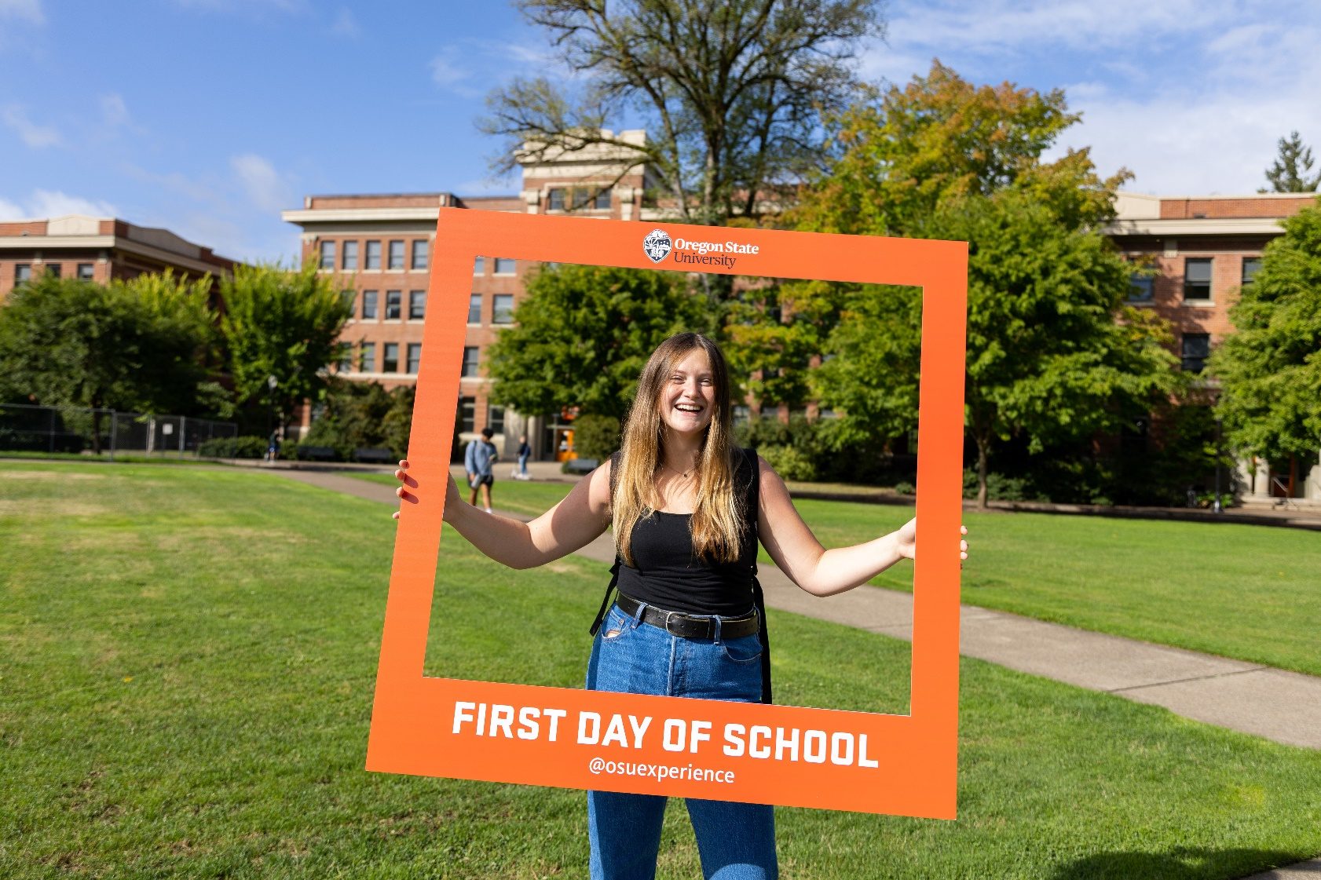
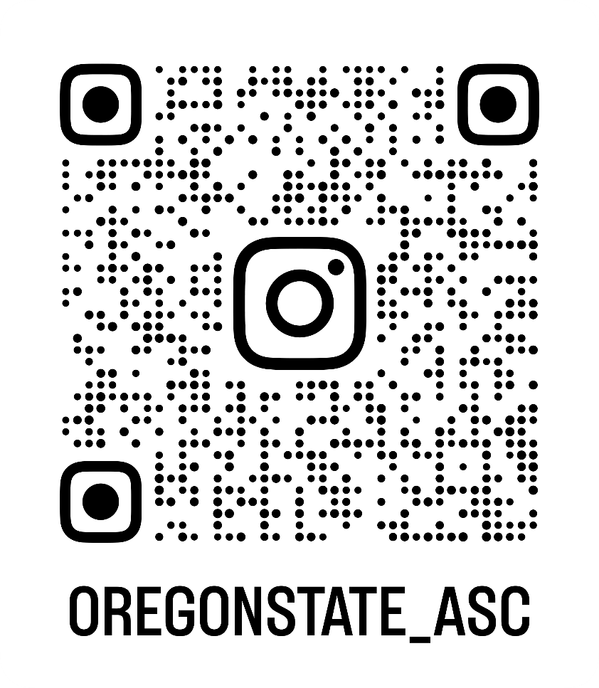
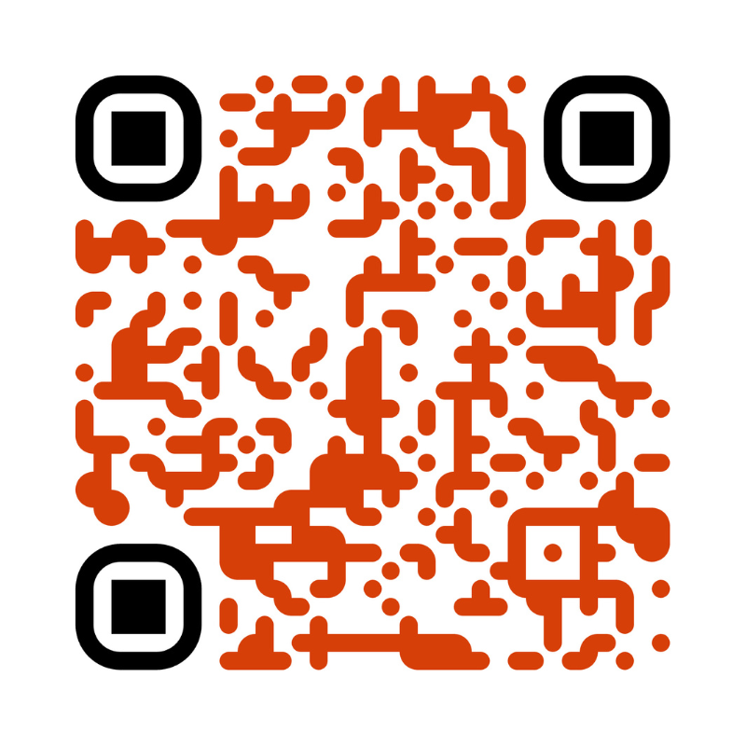
STAY CONNECTED
Follow us on Instagram!
CAREEROSU
Notes:
We know this was a quick session and there’s so much to absorb. As we leave you today, we hope you’ll remember this:
There are hundreds of student success professionals here. The pressure is not all on you to support your students! Together – on campus and off – we’re a team, a network of support for students.
Your student will continue to receive information that introduces resources and invites them into opportunities. It’s fabulous that you’re here, learning all you are, but you also don’t have to remember it all.
To beep connected, we want to share our office’s social media account – you can follow us both on Instagram to stay up to date on opportunities and information. When you chat with your student, consider the ways you might encourage them to follow these accounts (and others across campus!) and take advantage of what’s being offered, too.
Before we go, we want o invite you to reflect on how you might encourage your student to take action in utilizing these career & academic resources – everyone’s going to approach resource use and involvement differently. Your knowledge and experience from today can help you frame conversations and encourage connection. It’s a process! And we – and our campus colleagues – are here to help your student along the way.

Slide 20
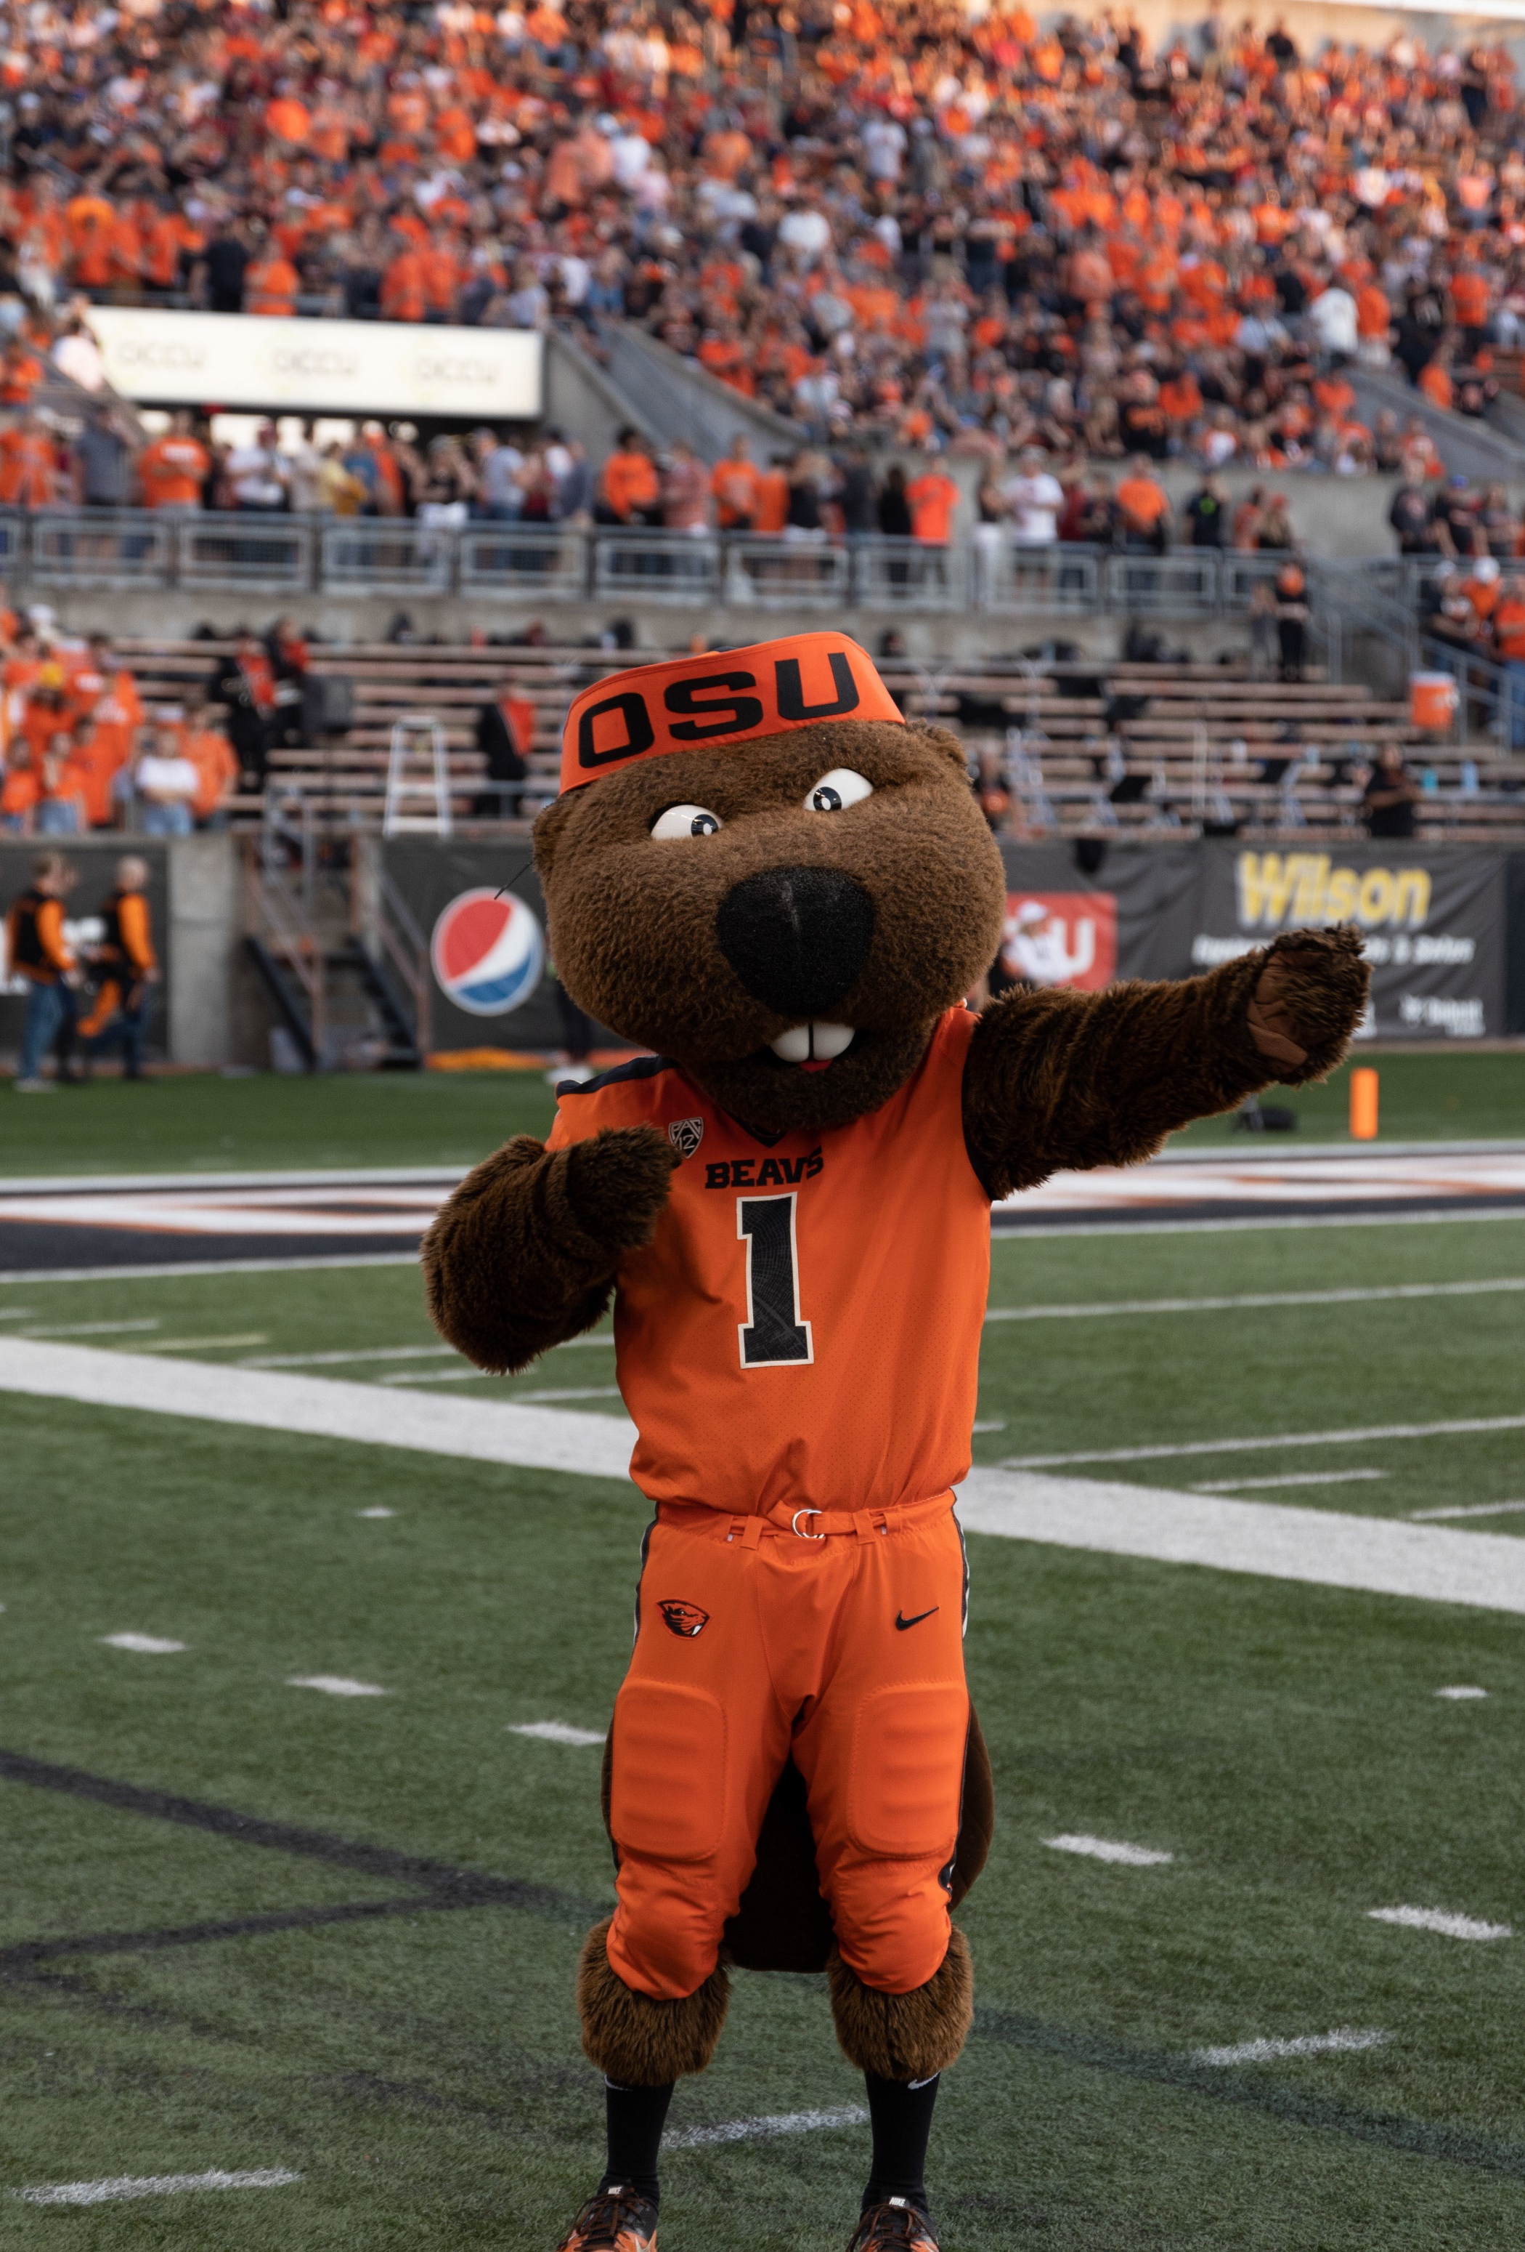

THANK YOU!
We can’t wait to see you in the fall!
Notes:
Thanks everyone! We’ll step away for the next session to set up, but we’ll stick around if anyone wants to connect with any questions. We appreciate you being here, we’re honored to get to work with your student throughout their OSU journey.

